Slide 1



Accessit Student Web App
USER GUIDE

Slide 2


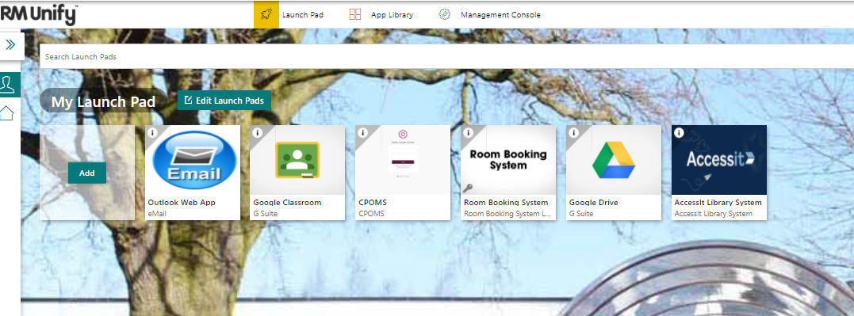
Log On
Log on to the computer with your network username and password
Open up an internet browser using
This will launch RMUnify
Library@astleycooper.herts.sch.uk

Slide 3


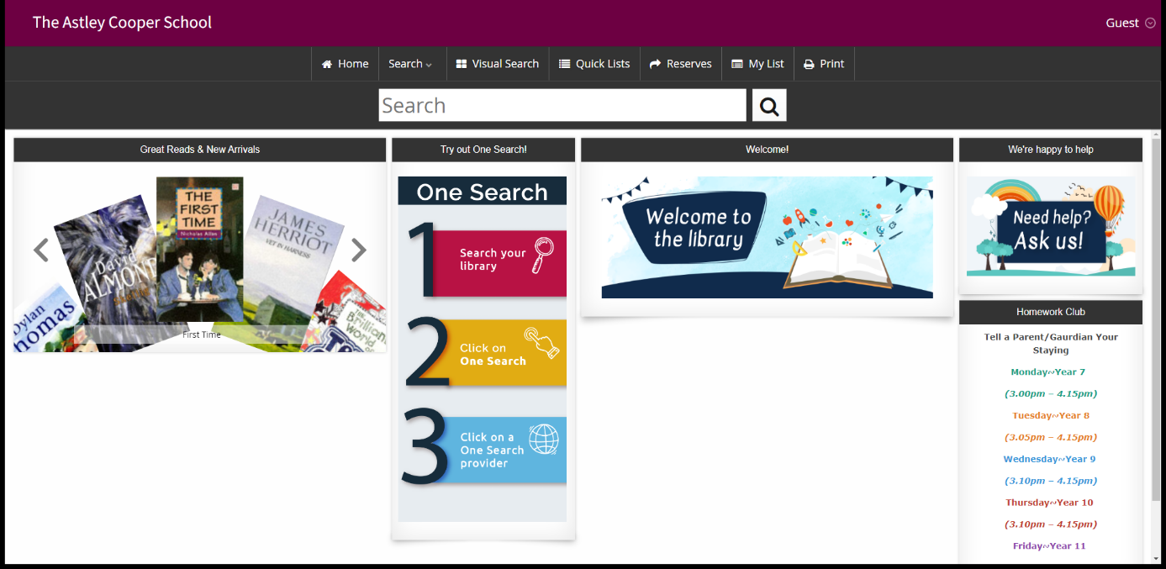
Accessing the Student Web App
Select the tile in RMUnify
The following screen will appear
You’re now logged
Library@astleycooper.herts.sch.uk

Slide 4
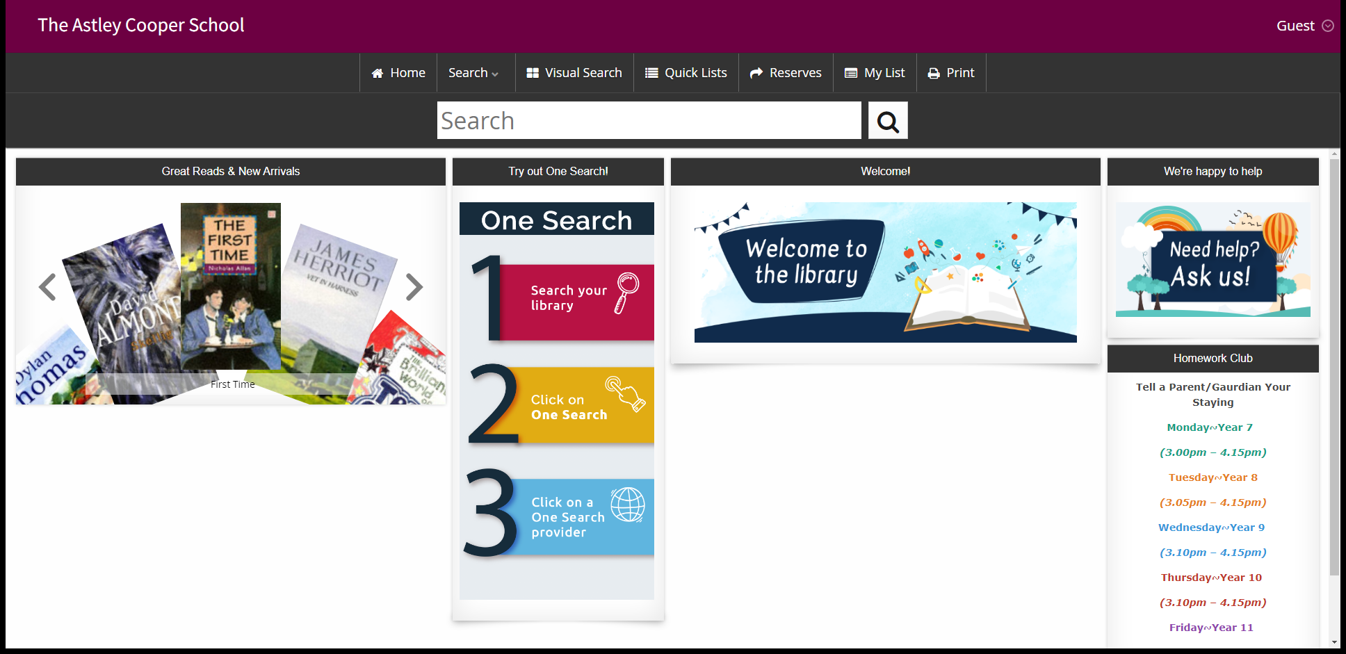
Log In As You To Reserve A Book
Your name should appear in the top right corner
Library@astleycooper.herts.sch.uk

Slide 5
Troubleshooting
If your name does not appear in the top right hand corner, exit the Accessit Student Web App and log back in
Re-enter your email address and password if you’re prompted to.
If you are prompted to change your password please do so.
BUT remember it for next time!
Library@astleycooper.herts.sch.uk

Slide 6

You’ve Done It
You have now gained access to the Library Student Web App
Library@astleycooper.herts.sch.uk

Slide 7
Your schools home page will currently look like this.
Library@astleycooper.herts.sch.uk

Slide 8

Collecting Reserved Books
During break and Lunch times or after school the following day.
Returning Books
During break and lunch time or after school
Library@astleycooper.herts.sch.uk

Slide 9
Any problems or questions please email the Librarian on
library@astleycooper.herts.sch.uk

Slide 10
Please watch the following video on the features of the Accessit Student Web App
Library@astleycooper.herts.sch.uk

Slide 11

Library@astleycooper.herts.sch.uk

