Slide 1
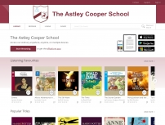


Wheelers ePlatform
eBook and Audiobook Platform
Now Available for The Astley Cooper School

Slide 2
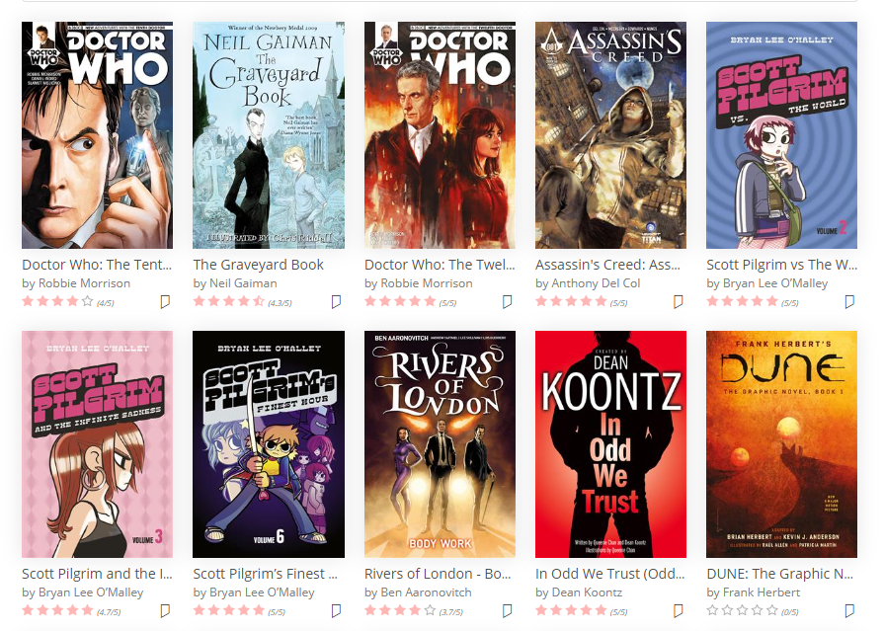
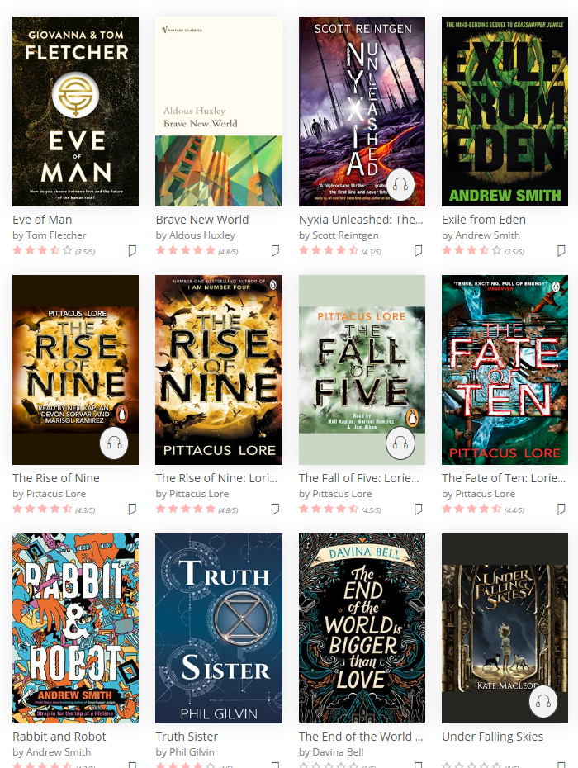
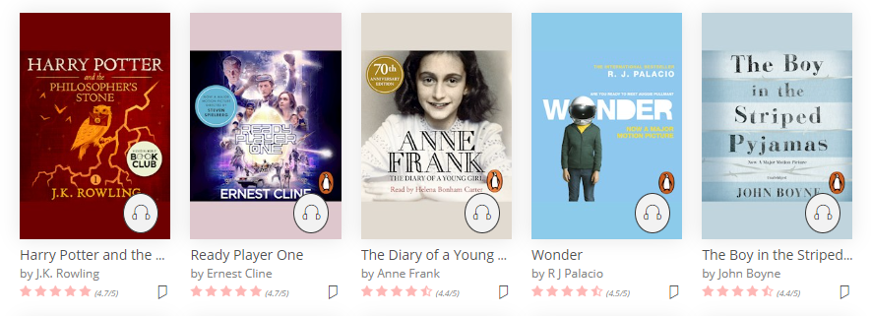
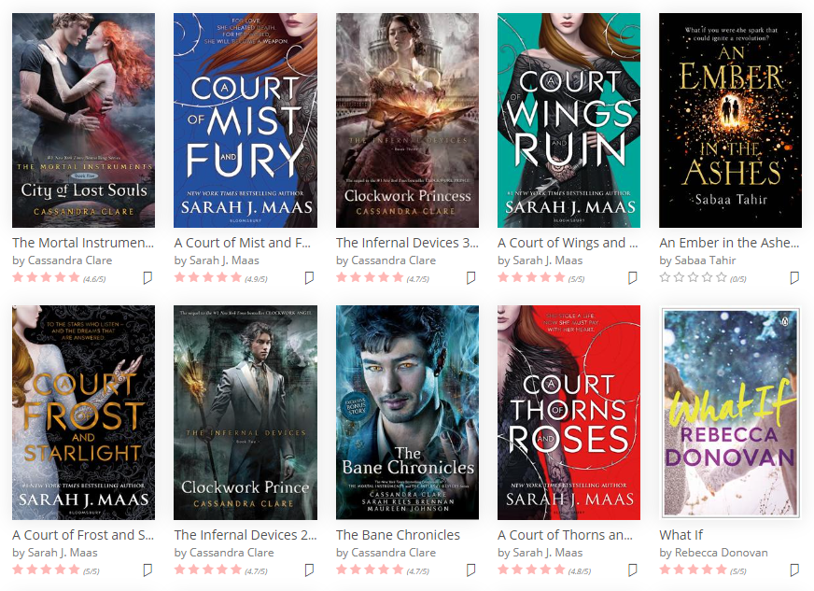
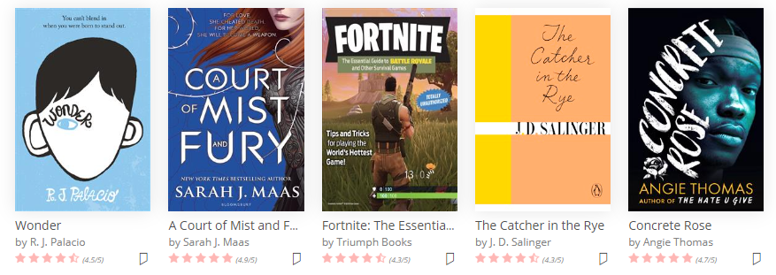
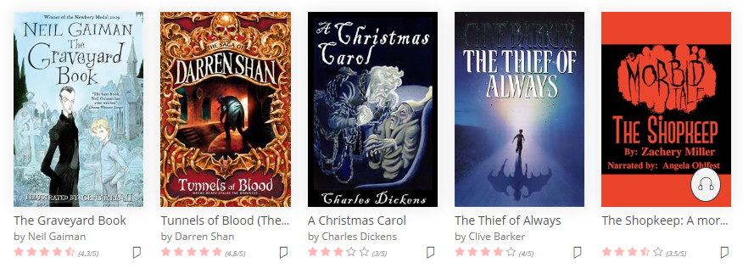
Wheeler’s ePlatform is a digital library now available to all Astley Cooper students with 10,000+ of eBooks and Audiobooks available.
GRAPHIC NOVELS
AUDIOBOOKS
ROMANCE
SCI-FI
EBOOKS
HORROR

Slide 3
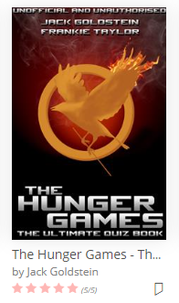
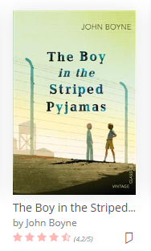
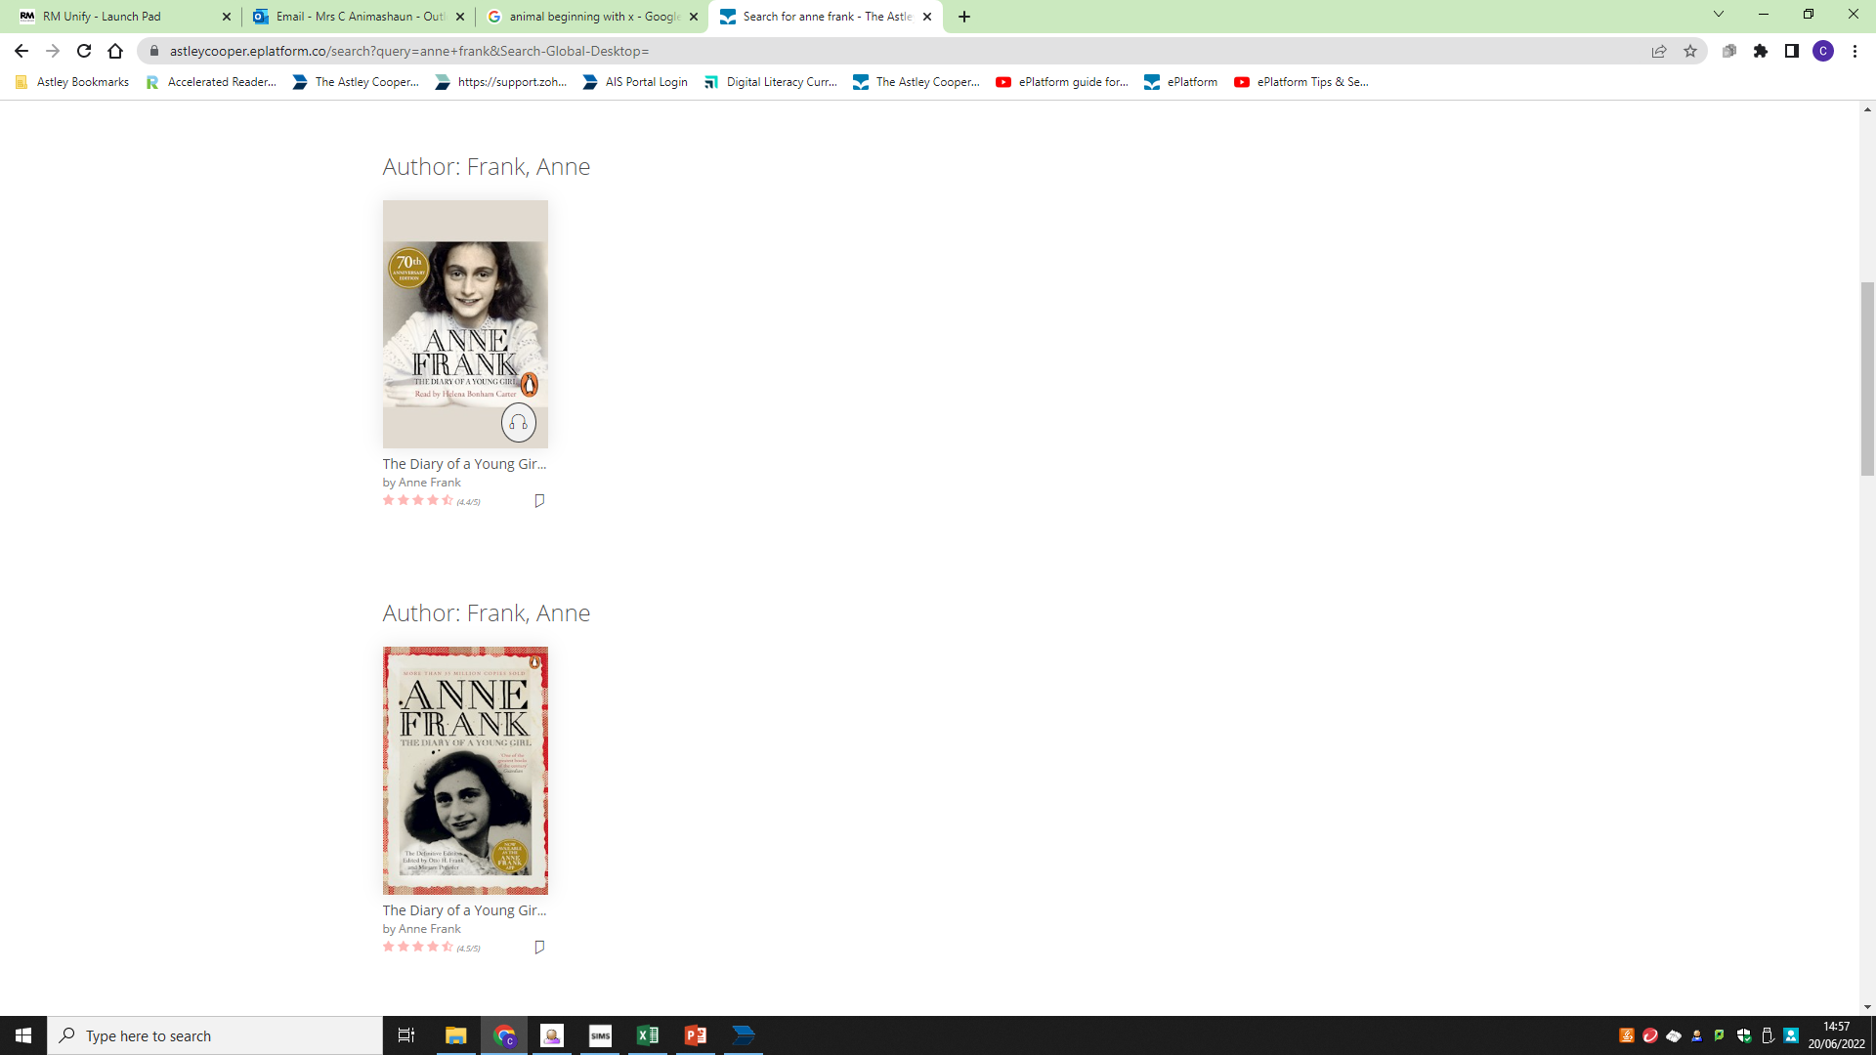
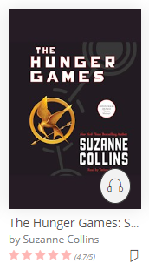
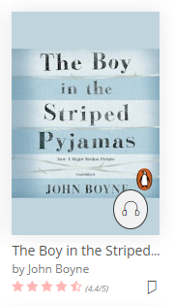
Borrow 2 titles at a time for 2 weeks – so why not borrow both the audiobook and eBook to listen and read-along together
GENIUS!!!
Titles automatically return after 2 weeks so no late reminders

Slide 4
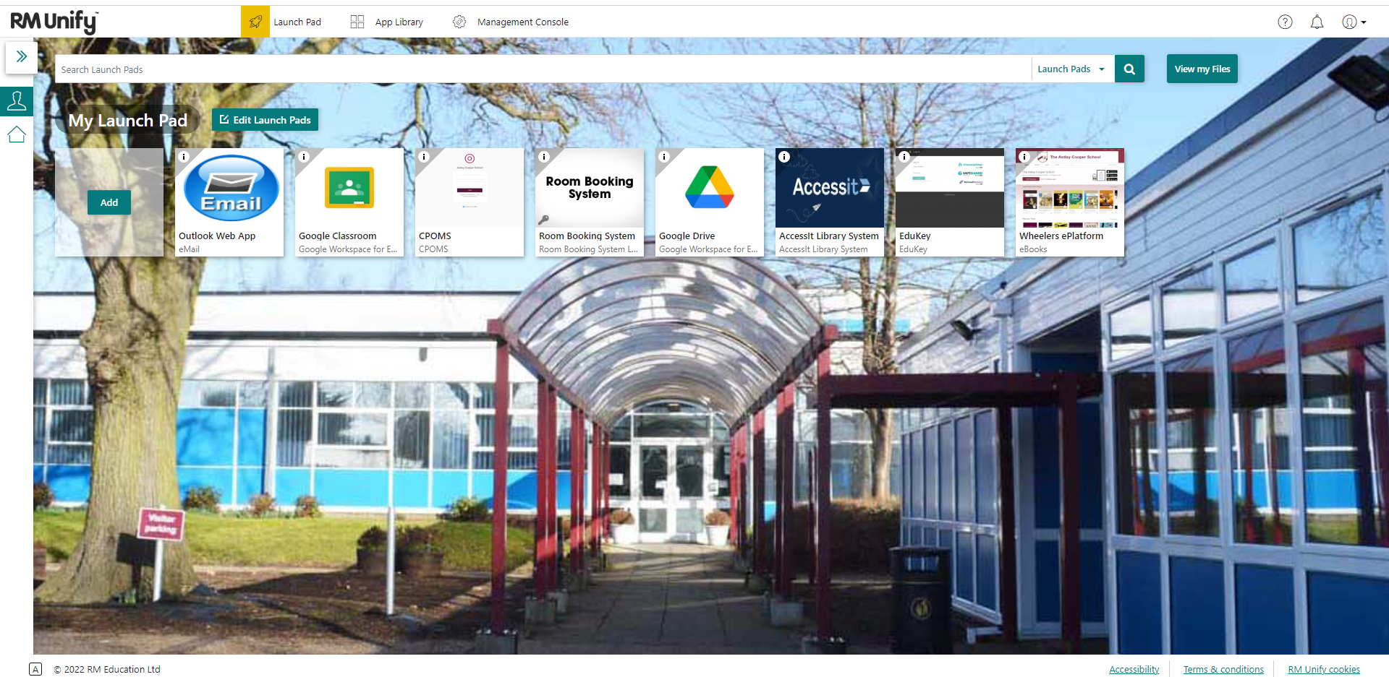
ePlatform is accessible via a tile in RM Unify (search and add to ‘my launch pad’ if not already visible)
Select the tile to launch Wheeler ePlatform

Slide 5
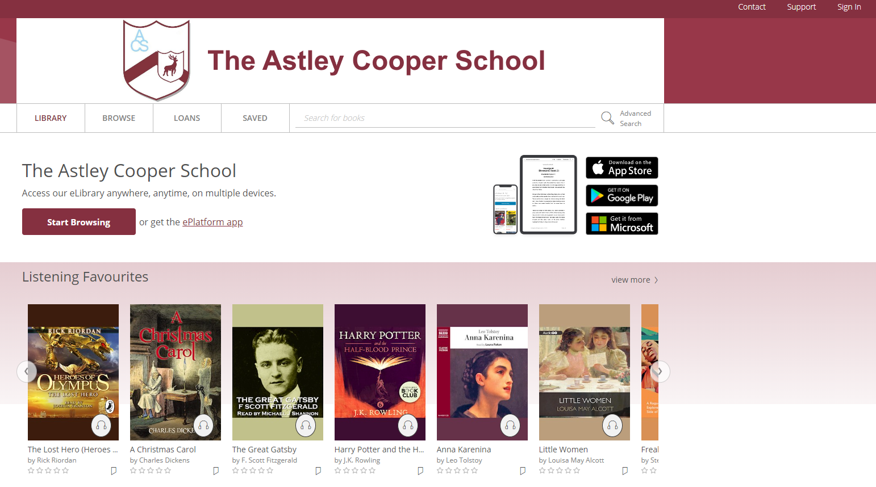
Locate and select ‘Sign In’ in the top right hand corner of the screen

Slide 6
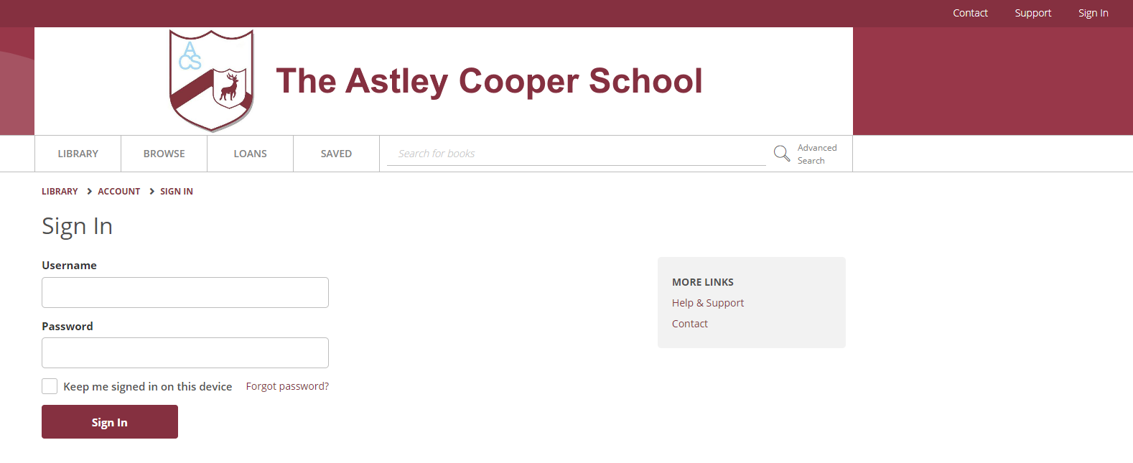
To log in use your school network username and password. These are what you use to log in to the school computers.
Network Username
Network Password

Slide 7
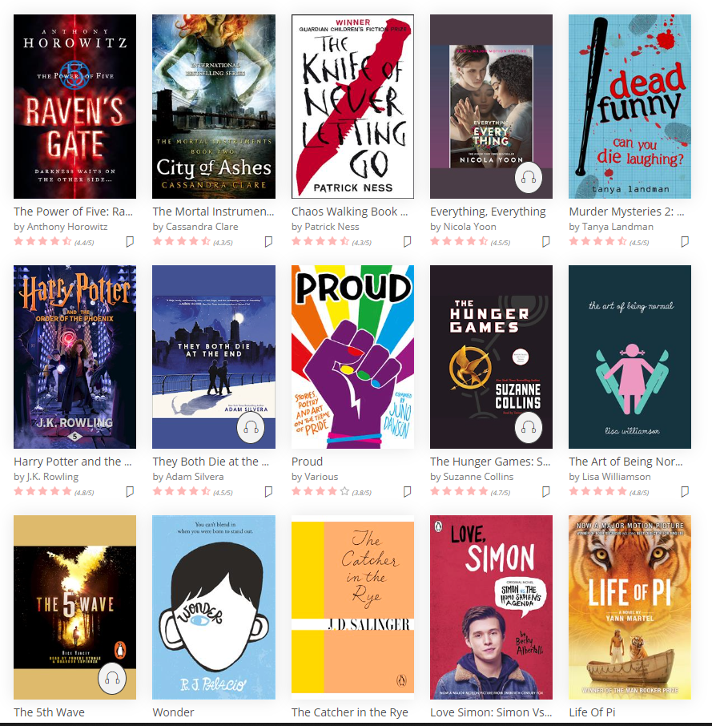
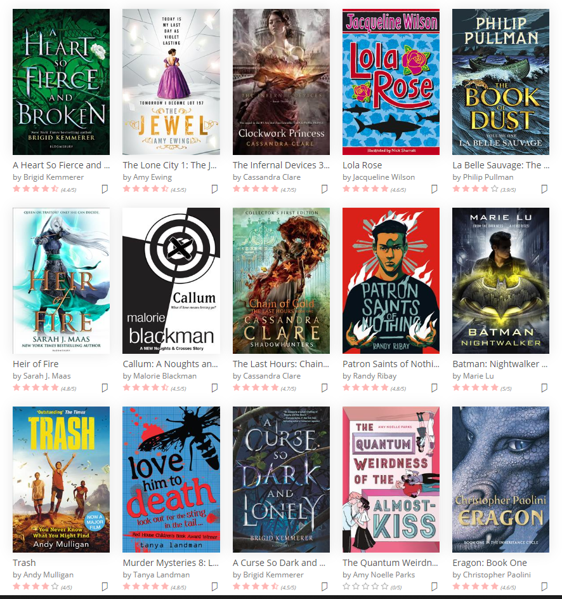
CONGRATULATIONS!!!
Now search and borrow an eBook or audiobook.

Slide 8
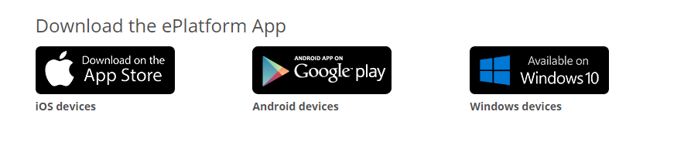
Download the ePlatform app on IOS/Android/Windows – to read on the go!
Please be aware - this ePlatform is totally separate from Accessit – the schools library system. The content will be different.
ENJOY!!!
And have a lovely summer full of reading.

Slide 9
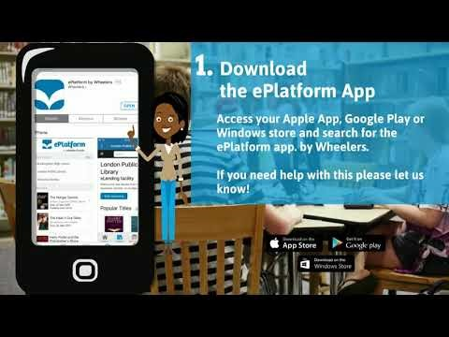
https://www.youtube.com/watch?v=-dWrO9HgTMk

