Slide 1
Christina Rossetti
Research Task - Poetry Component 3

Slide 2
BBC Radio 4 - Documentary - https://www.bbc.co.uk/sounds/play/b017mvwy
Listen to the BBC Radio 4 broadcast on Christina Rossetti’s life and Poetry.
Create notes of anything that you learn about Rossetti.

Slide 3
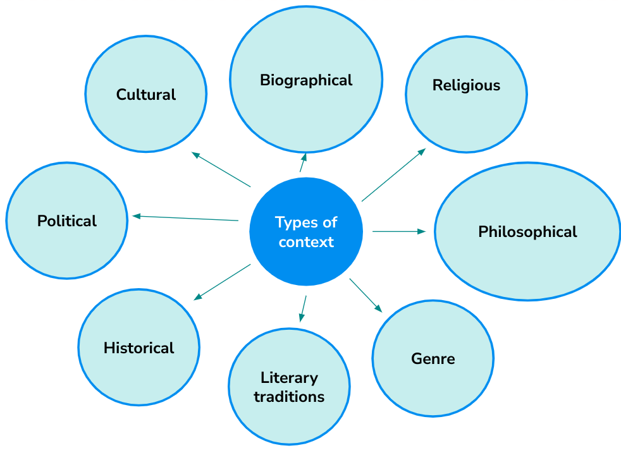
Research Task -
Complete research and notes on the poet Christina Rossetti based on these different types of context.
You need to understand her as a person in order to understand her as poet.

Slide 4
Reading
Prose Component 2

Slide 5
READING:
Handmaid’s Tale by Margaret Atwood
Link to purchase:
https://www.amazon.co.uk/Handmaids-Tale-Vintage-Classics/dp/1784873187/ref=pd_lpo_sccl_1/258-5093304-9656803?pd_rd_w=4H49N&content-id=amzn1.sym.efc89c20-c5a9-4620-b6cd-2f4e51bac956&pf_rd_p=efc89c20-c5a9-4620-b6cd-2f4e51bac956&pf_rd_r=WXMVPB0XD5YQ14609X0W&pd_rd_wg=FYHWQ&pd_rd_r=9591eaaa-dc04-4436-ae9b-e2c1e9521bec&pd_rd_i=1784873187&psc=1
Frankenstein by Mary Shelley
Link to purchase:
https://www.amazon.co.uk/Frankenstein-1818-Text-Penguin-Classics-ebook/dp/B071NCSKSP/ref=sr_1_6?keywords=frankenstein+by+mary+shelley&qid=1687954984&sprefix=frankenstein+by+%2Caps%2C105&sr=8-6

