Slide 1
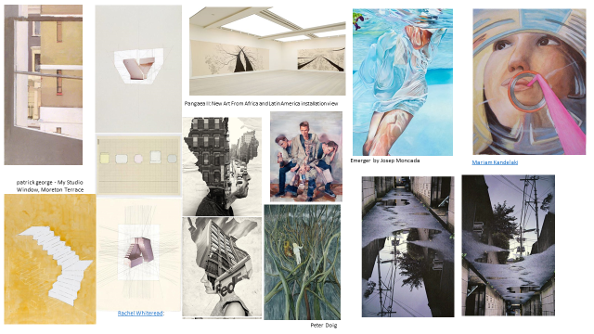
Exploring the theme: Inside/Outside
Write a list of 5 initial ideas when you think of the theme Inside/Outside

Slide 2
Produce your own mini sketchbook
Using the cardboard, range of papers and string – produce your own mini A5 sketchbook to work into over the summer.
Your drawing tasks are linked to your Google drive to work on.
Once you have pieced your sketchbook together – begin writing an interesting title on the outside.

Slide 3
Inside/Outside – analysing artists’ work
Create an Pinterest account. Create a pinterest folder called Inside/Outside and ‘pin’ 20 different images related to this theme.
Get 8-10 artist's images showing different POV - from inside, outside, etc. to print and stick on A3 paper. Group images if appropriate.
Label with name of artists and artwork.
Annotate each image to describe the particular viewpoint.
Explain how the artist has used the formal elements to communicate the different viewpoint. i.e, forshortening, use of scale, framing and composition, portraying inside/outside
Do a visual analysis/tracings to understand the compositional elements/spatial relationships
perspective lines, dynamic shapes and sections, etc,
cropping, zoom in/out.

Slide 4
Inside / Outside
Framing / windows;
Blurring of the boundary between inside and out;
Prisons / loss of freedom;
Breaking in the exterior barrier of things i.e. injuries in flesh resulting in the spilling out of insides;
Autopsy;
Opening a can of preserved fruit;
Pregnancy /birth;
Shelter from the rain;
The inconsistency between what is going on in the outside world and the inner turmoil of someone’s brain;
The change in state as something moves from outside to inside the human body (i.e. food > energy);
An environment that is devoid of ‘outside’ i.e. fluorescent lights / poor ventilation…lacking in plant life…unable to see nature outdoors…the dwindling human condition etc;
Apocalyptic future: what will happen if humans destroy the outdoor conditions; or a wall is erected to keep an infected virus-ridden population ‘outside’;
The peeling back of interesting things to expose what is underneath (inside)…i.e. banana skins, seedpods, envelopes.
Vegetables or interesting fruit sliced through to expose the insides (things with lots of seed / pips / bumpy skin etc);
Something opening to reveal something unexpected (i.e. inside a cardboard box);
The Impossible Staircase: indoors blending into outdoors in an indeterminable fashion / a blurring of dimensions;
Inside the human body: complex, organic form: the miracle of life (human anatomy drawings / x-rays;
Inside an animal carcass;
https://www.studentartguide.com/articles/a-level-art-exam-paper

Slide 5
Inside / Outside
The human ‘outside’ – an exterior presented to those around us. The fixation we have on creating the best exterior possible: weight control/dieting; makeup; cosmetic surgery; latest fashions;
Inside the earth: minerals / geology / the underworld;
Sectional views through a landscape (i.e. showing a slice through the ground / inside the earth): mines / slips / erosion / quarries, with trucks and machinery taking soil and rocks away;
The soul: inside / outside – leaving the body;
Plays upon storage and scale, i.e. miniature ‘scaled down’ items inside other items, like large wild animals stored inside tiny jars;
Castings of the insides of objects – things you don’t normally think about – that are then exposed for all to see;
Walls / divisions / outsiders;
Deterioration that has occurred to something as a result of being left outside (i.e. an ice sculpture that is left in the sun or a decayed, rusted, weathered structure showing the long term effects of the elements);
Light streaming in a window from outside;
Kids in a daycare facility looking longingly outside;
Animals in a small enclosure: a sorry life in comparison to those wild and free outside;
Looking outside from an unusual perspective, i.e. as if you are a mouse looking through a small crack into a room;
Inside a bomb shelter;
Inside is meant to equal haven / shelter: what if inside is not this at all: a crime scene / an inside that has been violated;
In the palm of your hand;
The contents of something spilling out;
Shellfish or snails inside their shells.
https://www.studentartguide.com/articles/a-level-art-exam-paper

Slide 6
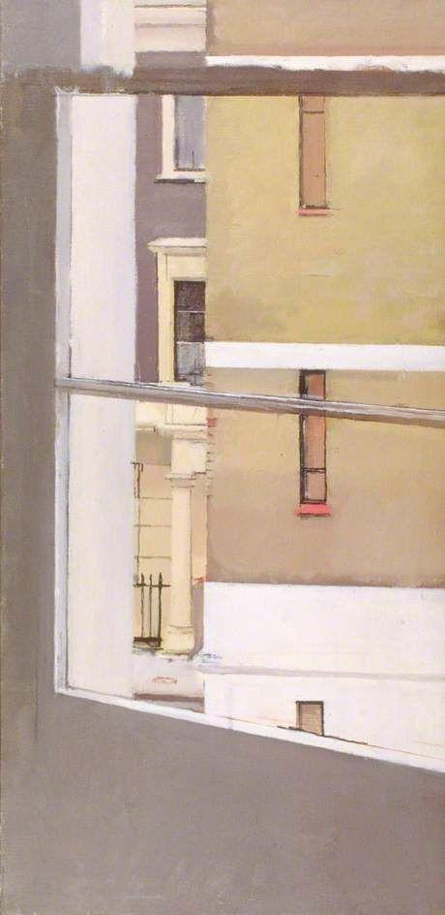
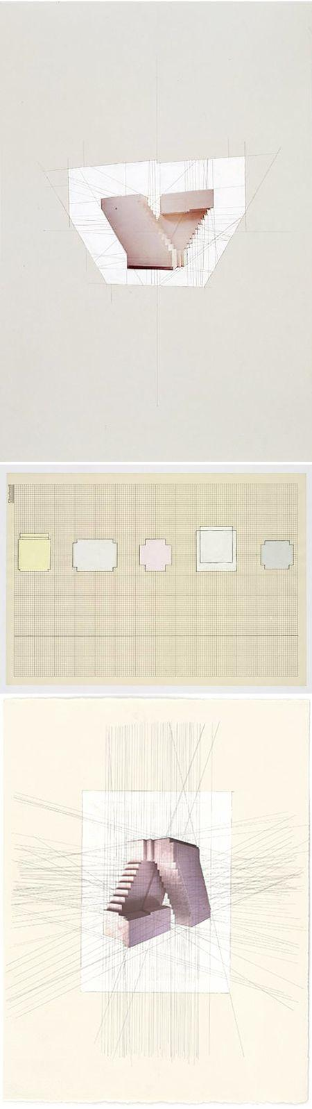
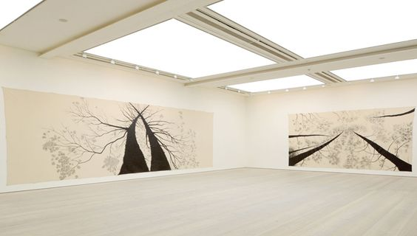
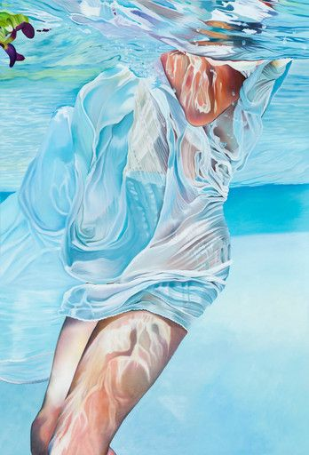
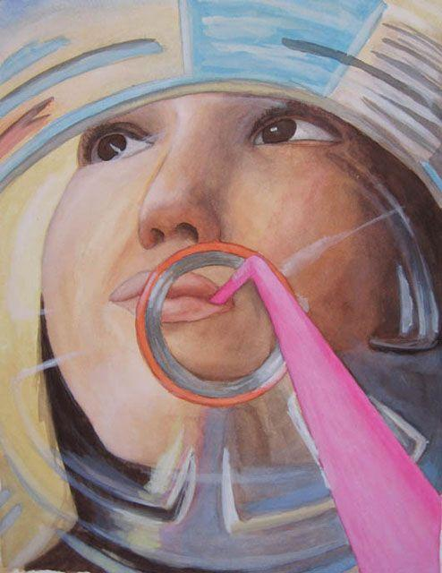
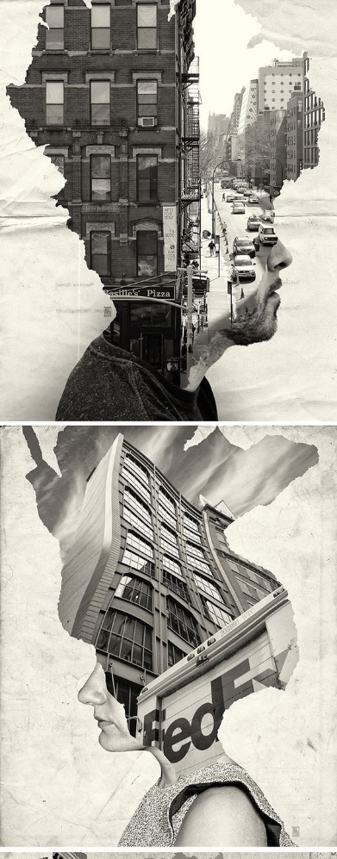
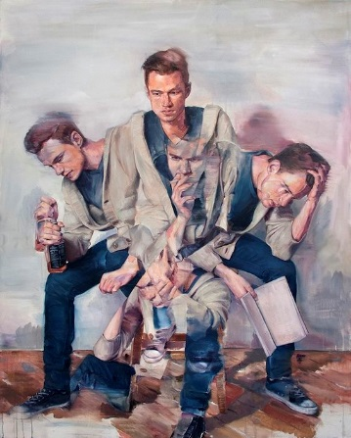
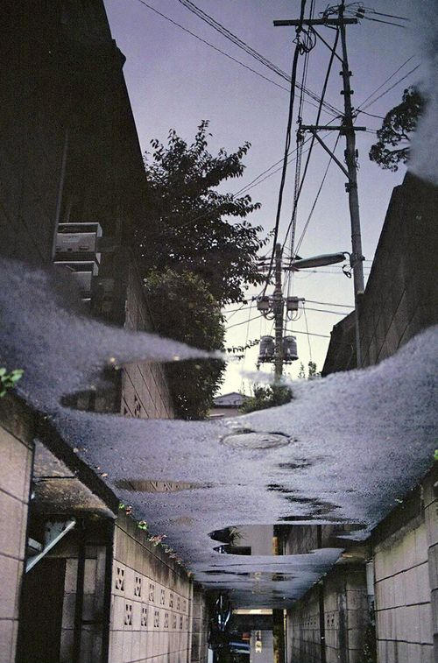
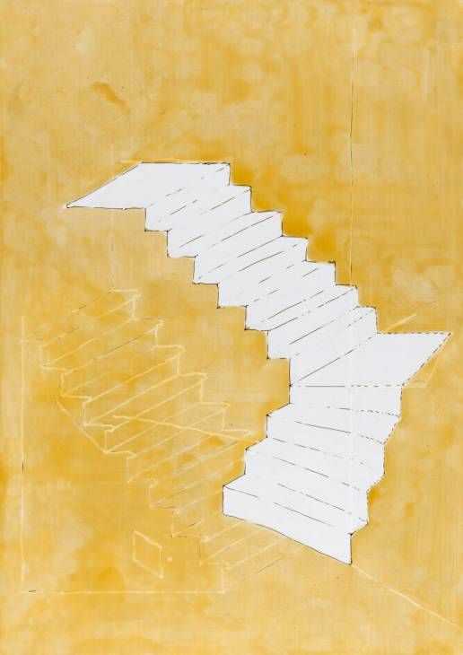
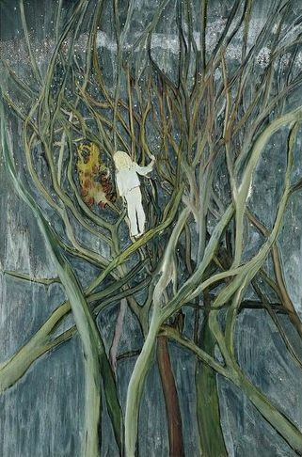
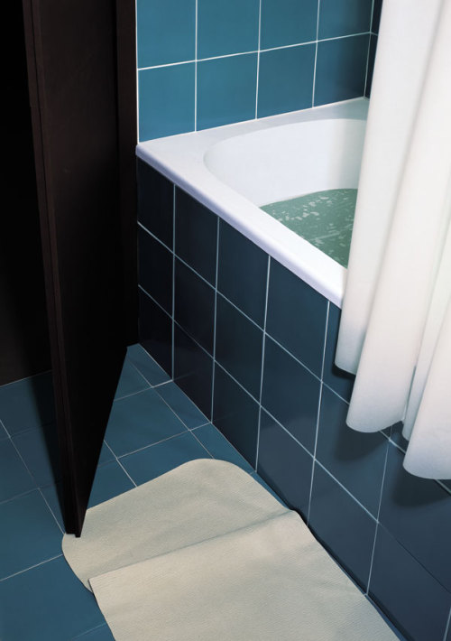
Pangaea II: New Art From Africa and Latin America installation view
Emerger by Josep Moncada
Mariam Kandelaki
patrick george - My Studio Window, Moreton Terrace
Rachel Whiteread:
Peter Doig
Thomas Demand “Bathroom" 1997

Slide 7
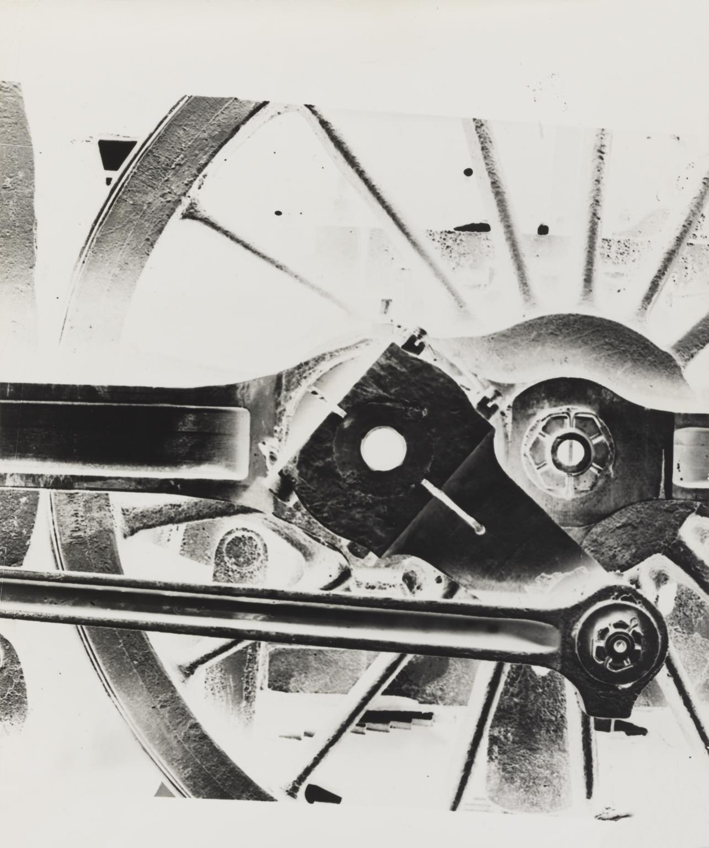
https://www.tate.org.uk/art/artworks/kepes-locomotive-wheel-p80546
György Kepes Locomotive Wheel c.1939–40
This is one of a large group of photograms and studies in modernist photography in Tate’s collection by the Hungarian-born photographer, painter, designer, teacher and writer, Gyorgy Kepes.
Essentially abstract images, the photograms exist metaphorically between science and art: as dematerialised light recordings of natural objects they have close links with Kepes’s later interest in scientific records.
The photograms he produced during this time, including the ones in Tate’s collection, demonstrate the fundamental aspects of his artistic personality, such as social consciousness, an interest in the formal qualities of light and the sensuousness of surfaces, and an exploration of an abstraction derived from nature and real objects. The imagery in these works includes studies with geometric forms such as prisms and cones, mechanical forms such as gears, domestic objects including sieves and string, more organic forms such as leaves, rocks, feathers and bone, and typography. Although Kepes did not himself view photography per se as a central concern, it formed a link between his painting, films and technological and environmental art projects. Light, the essence of photography, is at the heart of his practice.

Slide 8
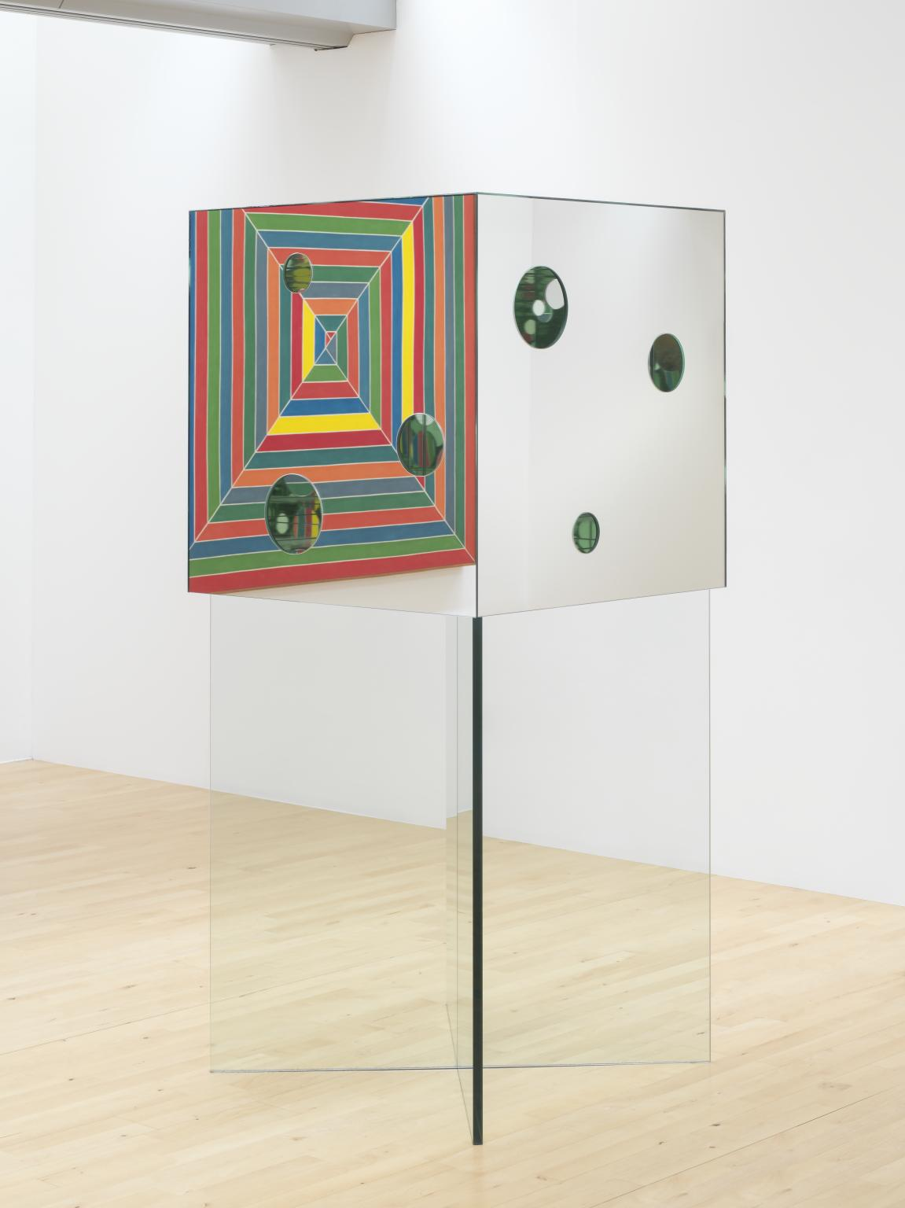
https://www.tate.org.uk/art/artworks/kusama-the-passing-winter-t12821
Yayoi Kusama The Passing Winter 2005
The Passing Winter 2005 is a sculpture comprising a cube positioned on two thick panes of glass, which are arranged to form an x-shaped pedestal. The cube, which is also made of glass, has an interior and exterior lined with mirrors, and its sides each contain three circular holes of different sizes arranged in varying compositions. Viewers are invited to look through these holes to the inside of the box and in doing so can see the circular shapes that are cut into the cube’s walls reflected infinitely across its mirror-lined interior. This gives the impression of an indefinite, ever-receding space in which the reflected circles seem to float. The spectator might also see reflections of other viewers peering in through holes in the box’s other sides. The cube’s mirrored surfaces cause its appearance to alter with varying environmental conditions: the reflected dots inside the box take on different colours depending on the colour of the surrounding room, and the reflections alter in brightness depending on light conditions.

Slide 9
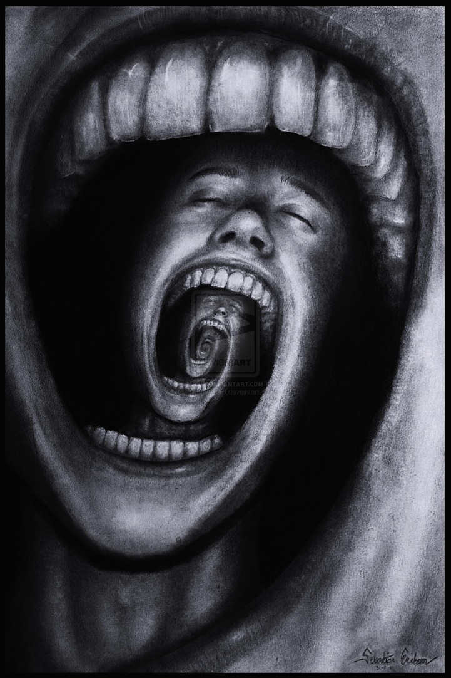
https://mymodernmet.com/sebastian-eriksson-surreal-art/
Sebastian Eriksson is an 18-year-old up-and-coming surrealist artist living in Sweden. Not only is his artwork amazing, it's extremely thought-provoking as he adds descriptions of how his pieces relate to his life.
For instance, in the piece above, he states: “This is another paradox that I've been working on for a couple of days. It describes a person with psychological problems such as schizophrenia, insanity, depression or other mental problems. His endless screaming makes his own mind eat him up. I have periods in my life where I feel like this. I wanted to make an illustration of my thoughts and my pain within.”
And for the piece immediately below: “One day I felt like I was lost and I had too much things to think about. Like I was stuck in a maze and couldn't get out.”

Slide 10
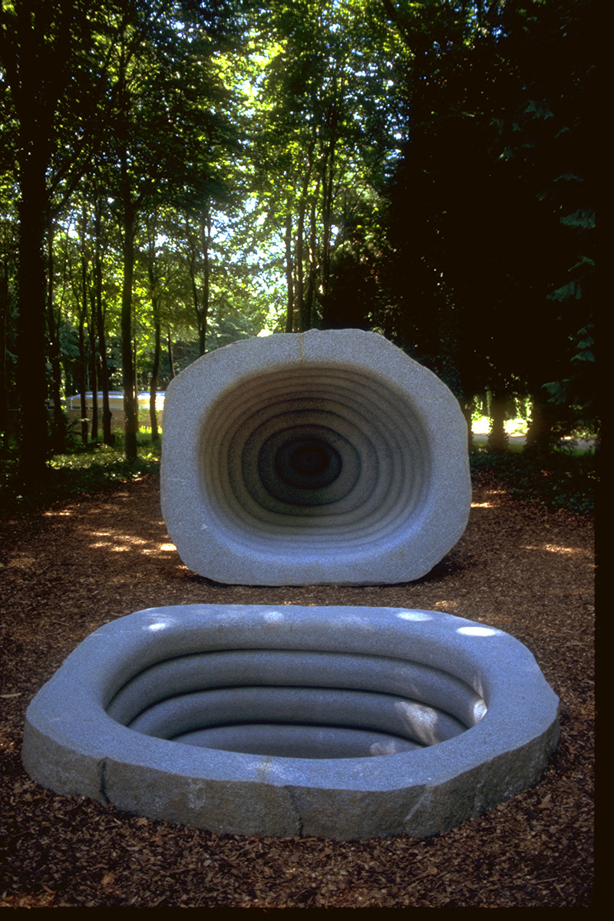
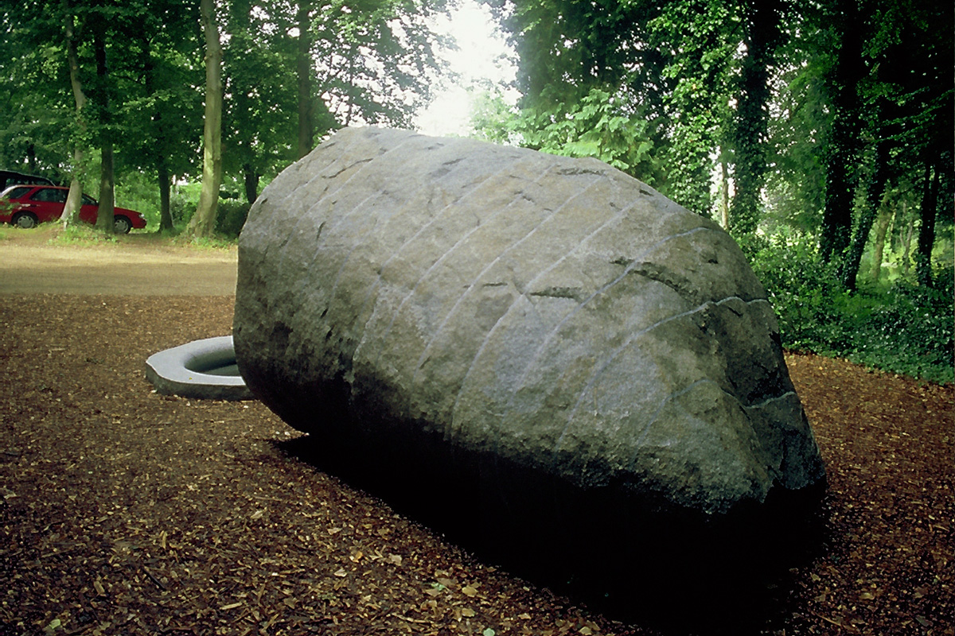
Womb Tomb
2000
Granite Boulder
230 x 335 x 270 cm
213 x 270 x 230 cm
https://www.peterrandall-page.com/sculptures/womb-tomb/

Slide 11
Analyse the composition.
Describe how the elements have been arranged.
Explain the effect this creates – how it leads the viewers eye. The feeling/atmosphere.
Womb Tomb
2000
Granite Boulder

Slide 12


