Slide 1
Year 12 Induction lesson
Quadratics
Tuesday 1 July 2025
Expectations
Lesson
Transition work

Slide 2
Lessons and homework
8 lessons a fortnight
Pure 2/3, Stats and Mechanics 1/3
You will need to do a minimum of 4 hours of independent study in a week
Homework will be given every week.

Slide 3

FX-CG100 | CASIO

Slide 4
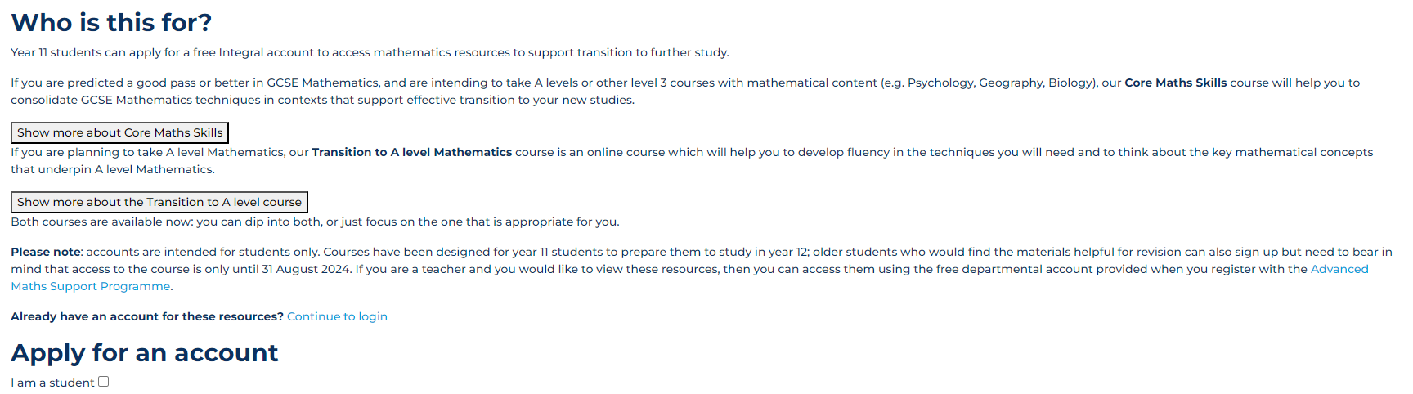
Transition work #1 (Compulsory)
Online using Integral – you need to apply for your own account
https://my.integralmaths.org/integral/self_reg/self_reg_students.php
MAKE SURE YOU DOWNLOAD THE CERTIFICATES AND BRING THEM WITH YOU ON THE FIRST DAY.
Tick the box ‘I am a student’

Slide 5


Slide 6
Transition work #2 (Compulsory)
Data Set - View the data set document and complete the questions about this.

Slide 7
Transition work #3
Essential skills bridging task
This is optional but I would still recommend you to keep practising these questions so that you are REALLY prepared for the upcoming two years.

Slide 8
Quadratic equations and graphs
Objective
To revise quadratic equations and non-linear simultaneous equations, while looking ahead to ‘A’-level and the importance of the discriminant

Slide 9
x² + 10x + k = 0
Solve the equation x² + 10x + 21 = 0
(1)
Solve the equation x² + 10x – 8 = 0
(2)
•
What is the same and what is different about these equations?
•
Choose a value of k between –50 and 50.
Solve the equation x² + 10x + k = 0 for your value of k.
Is your equation more like (1) or (2), or neither of them?
•
Working with a partner or small group, solve the equation for the following values of k. Describe what happens each time.
k = 5 | k = 16 | k = 25 | k = 40 | k = –24 | k = –5

Slide 10
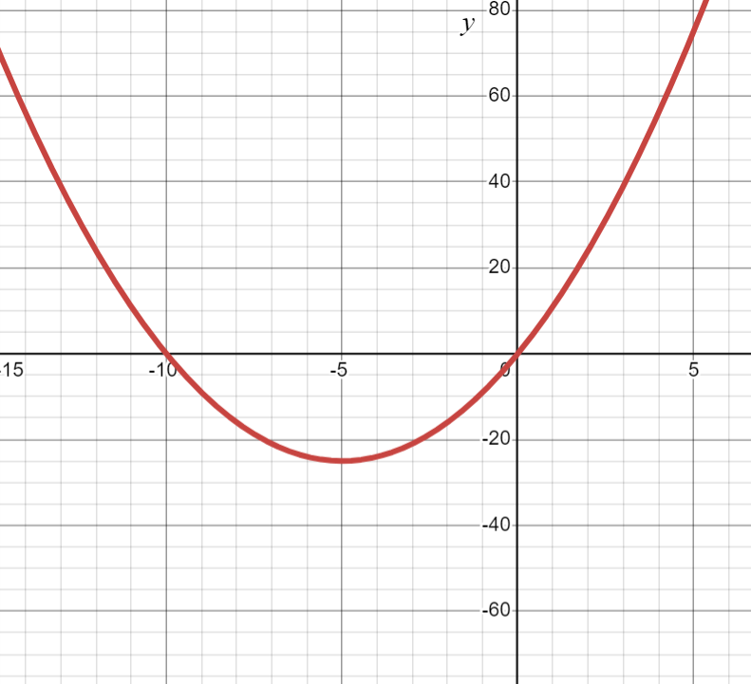
The graph of y = x² + 10x + k
You will need the Desmos file
y = x² + 10x – k
The value of k is set at k = 0, but can be changed using the slider.
Change the value of k to generate graphs corresponding to each ‘type’ you found on the previous slide.
Take a screenshot for each type.
Notes:
The blue equation is hyperlinked to the file.

Slide 11
The graph of y = x² + 10x + k
Complete each sentence:
The equation x² + 10x + k = 0 has two solutions when k is …
The equation x² + 10x + k = 0 has no solutions when k is …
The equation x² + 10x + k = 0 has one solution when k is …
The equation x² + 10x + k = 0 has integer solutions when k is …

Slide 12
The graph of y = x² + 10x + k
x² + 10x + k = 0
Complete each sentence:
Complete the square
The equation x² + 10x + k = 0 has two solutions when k is …
(x + 5)² – 25 + k = 0
The equation x² + 10x + k = 0 has no solutions when k is …
Rearrange to isolate the square:
(x + 5)² = 25 – k
The equation x² + 10x + k = 0 has one solution when k is …
Make x the subject:
x + 5 = ± 25 – k
√
The equation x² + 10x + k = 0 has integer solutions when k is …
x = –5 ± 25 – k
√

Slide 13
The graph of y = x² + 10x + k
x² + 10x + k = 0
Complete each sentence:
⇒
x = –5 ± 25 – k
√
The equation x² + 10x + k = 0 has two solutions when k is …
25 – k > 0
, so k < 25
The equation x² + 10x + k = 0 has no solutions when k is …
25 – k < 0
, so k > 25
The equation x² + 10x + k = 0 has one solution when k is …
25 – k = 0
, so k = 25
The equation x² + 10x + k = 0 has integer solutions when k is …
25 – k is a square number
k is the product of two integers whose sum is 10

Slide 14
x² + 12x + k = 0
See if you can find a value of k (between –50 and 50) for each of the following cases:
•
x² + 12x + k = 0 has two integer solutions
•
x² + 12x + k = 0 has two non-integer solutions
•
x² + 12x + k = 0 has no solutions
•
x² + 12x + k = 0 has exactly one solution
Use the Desmos file to generate a graph to illustrate each case.
How many possible values of k are there for each case?
Repeat the exercise for the equation x² – 6x + k = 0

Slide 15
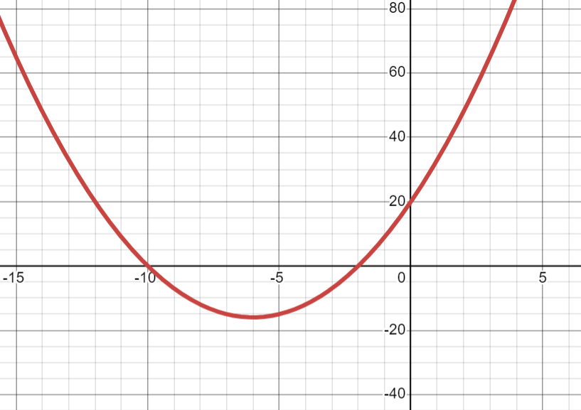
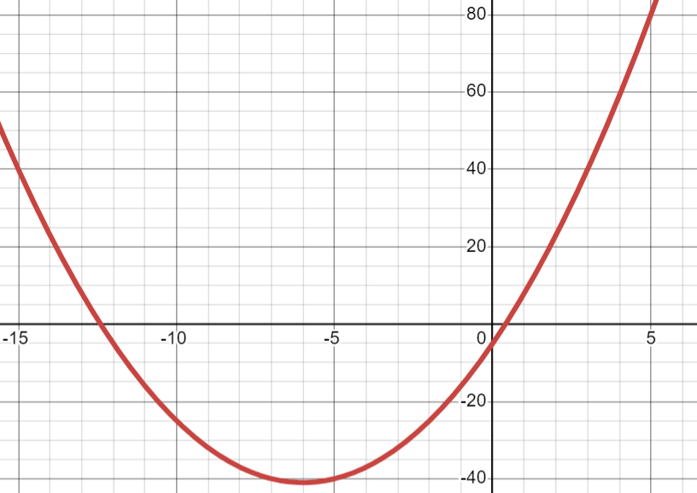
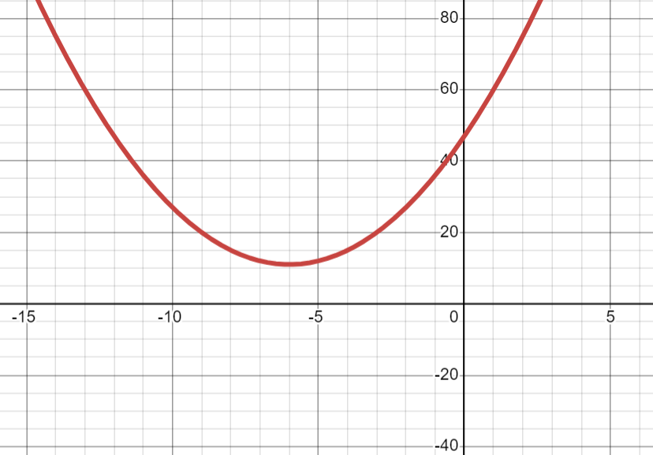
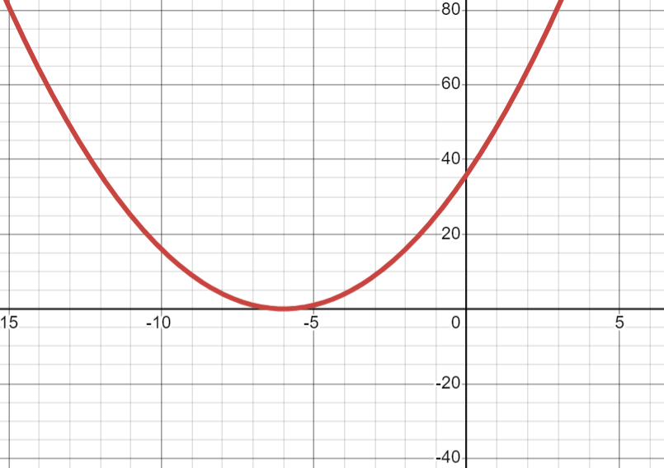
x² + 12x + k = 0
k = 20
k = –5
Two integer roots
Two non-integer roots
k = 50
k = 36
No roots
Exactly one root

Slide 16
Simultaneous equations
Solve each set of simultaneous equations:
(1)
y = x²
(2)
y = x²
y = 2x + 3
y = 2x + 1
(3)
y = x²
(4)
y = x²
y = 2x – 1
y = 2x – 3
Use Desmos to illustrate what happens in each case.
Describe the number of solutions of the simultaneous equations for different values of k.
y = x²
y = 2x + k

Slide 17
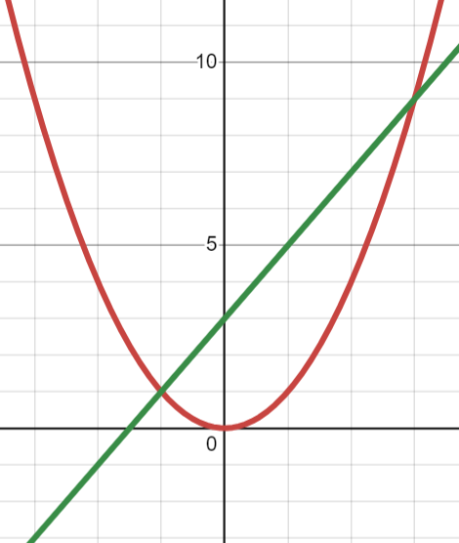
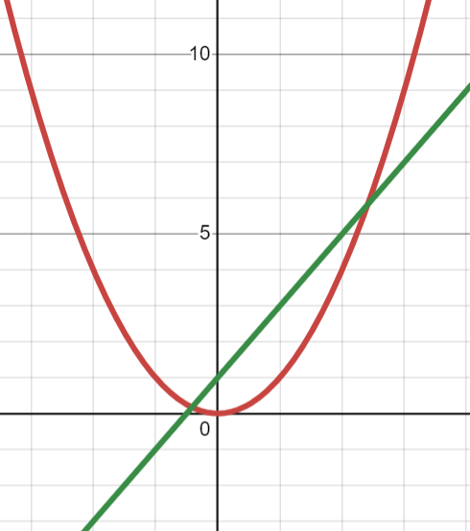
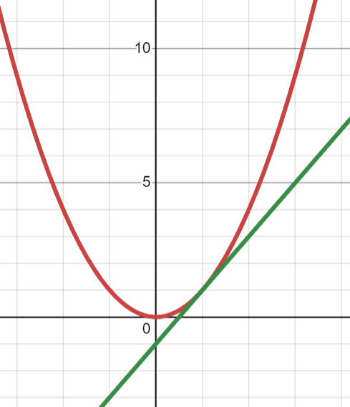
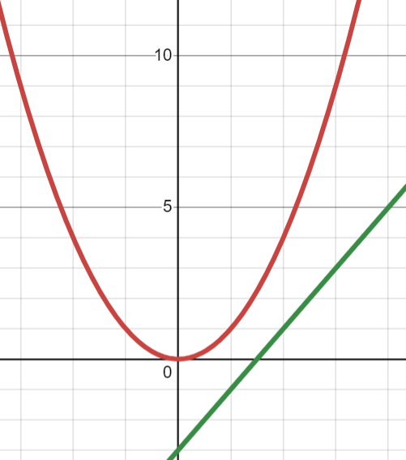
Simultaneous equations
(1)
y = x²
(2)
y = x²
y = 2x + 3
y = 2x + 1
(3)
y = x²
(4)
y = x²
y = 2x – 1
y = 2x – 3

Slide 18
Simultaneous equations (2)
Solve each set of simultaneous equations:
(1)
x² + y² = 50
(2)
x² + y² = 50
x + y = 2
x + y = 6
(3)
x² + y² = 50
(4)
x² + y² = 50
x + y = 10
x + y = 14
Use Desmos to illustrate what happens in each case.
Describe the number of solutions of the simultaneous equations for different values of k.
x² + y² = 50
x + y = k

Slide 19
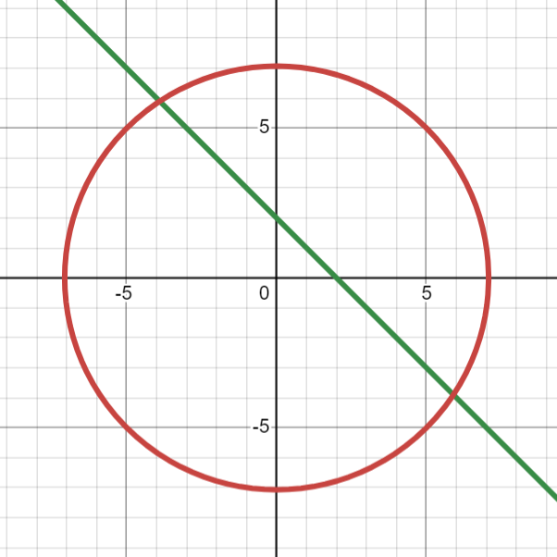
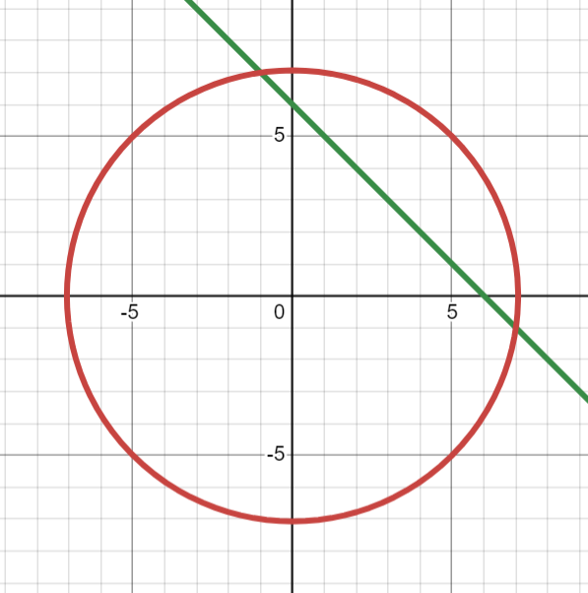
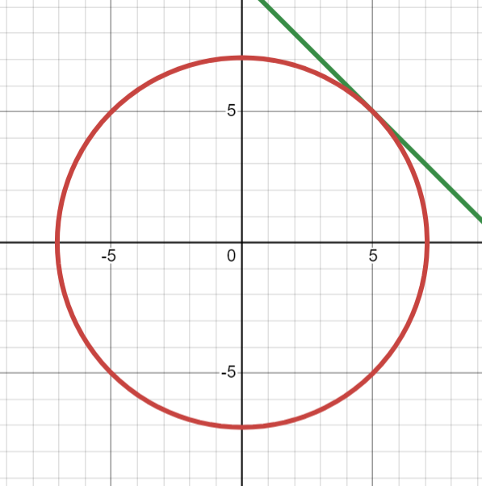
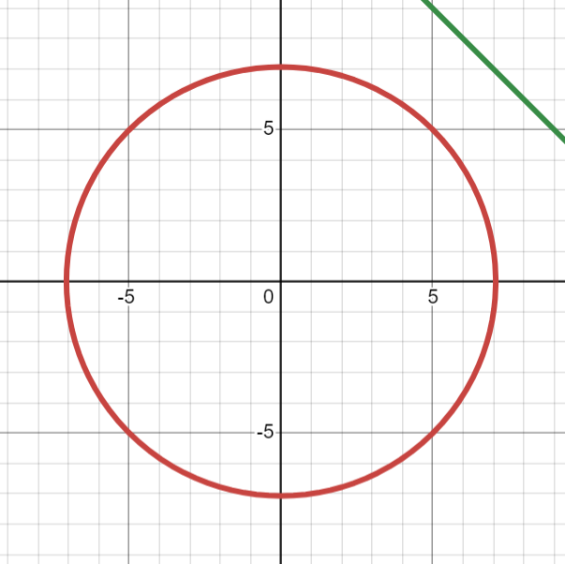
Simultaneous equations (2)
(1)
x² + y² = 50
(2)
x² + y² = 50
x + y = 2
x + y = 6
(3)
x² + y² = 50
(4)
x² + y² = 50
x + y = 10
x + y = 14

Slide 20
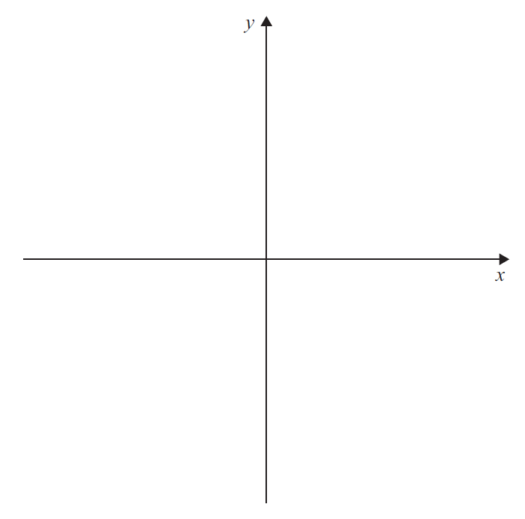
Quadratics and roots
AQA ‘A’-level question, June 2018 Paper 2
The curve, C, has equation y = x² – 6x + k, where k is a constant.
The equation x² – 6x + k = 0 has two distinct positive roots.
(a)
Sketch C on the axes provided.
[2 marks]
(b)
Find the range of possible values for k.
Fully justify your answer.
[4 marks]
Notes:
This GCSE question is effectively about translating component form into magnitude/direction form, though only the direction is asked for (and not much, if any, trigonometry is needed).

Slide 21
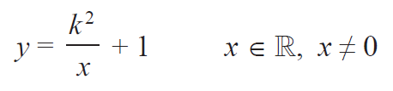


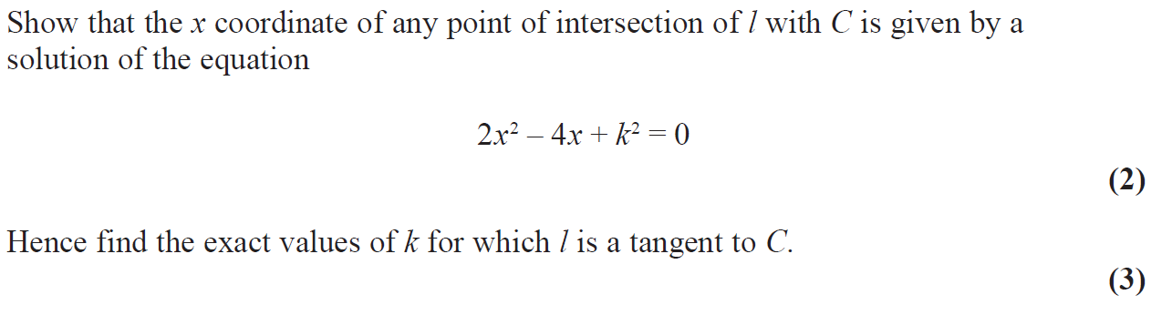
Quadratics and roots
Edexcel ‘AS’-level question, May 2019 Paper 1
Notes:
The intention is NOT to go through this question in any detail. It is just to show how this lesson relates to future ‘A’-level work, and how trig functions can be used to model real-world situations. In this question, in part (b) the force of 150 N will need to be resolved into its horizontal and vertical components.

Slide 22

Notes:
Please encourage students to feed back on this lesson, using this QR code.

