Slide 1
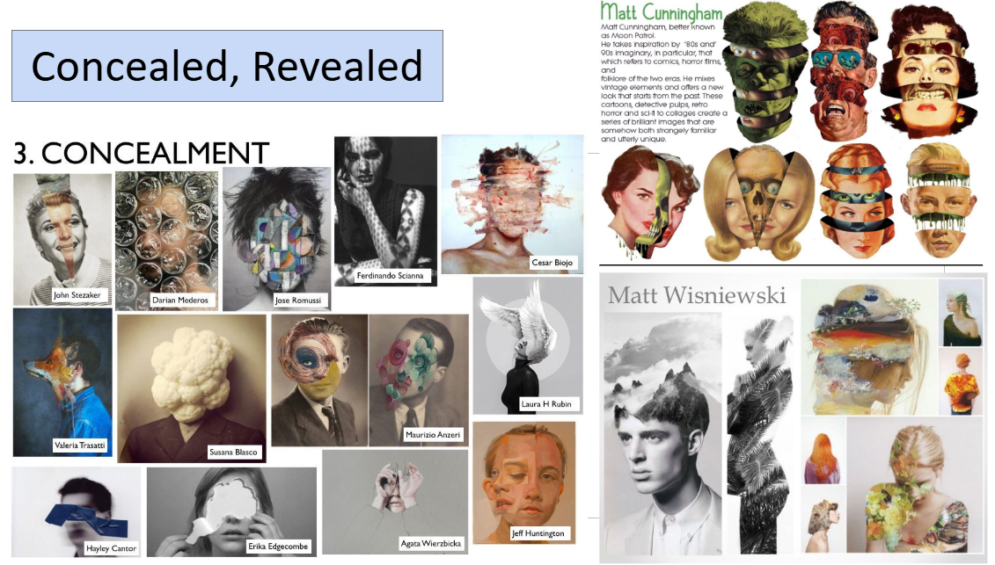
Exploring the theme
Write a list of 5 initial ideas when you think of the theme Concealed/Revealed

Slide 2
Produce your own mini sketchbook
Using the cardboard, range of papers and string – produce your own mini A5 or A4 sketchbook to work into over the summer.
Your drawing tasks are linked to your Google drive to work on.
Once you have pieced your sketchbook together – begin writing an interesting title on the outside.

Slide 3
Concealed/Revealed – analysing artists’ work
Create an Pinterest account. Create a pinterest folder called Concealed/Revealed and ‘pin’ 20 different images related to this theme.
Get 8-10 artist's images showing different points of view - from concealed, revealed, etc. to print and stick on A3 paper. Group images if appropriate.
Label with name of artists and artwork.
Annotate each image to describe the particular viewpoint.
Explain how the artist has used the formal elements to communicate the different viewpoint. i.e, foreshortening, use of scale, framing and composition, portraying inside/outside
Do a visual analysis/tracings to understand the compositional elements/spatial relationships
perspective lines, dynamic shapes and sections, etc,
cropping, zoom in/out.

Slide 4
Concealed / Revealed
unravelling mysteries and discovering hidden secrets
artefacts that intentionally conceal objects or messages
subtle symbolic objects in the background of paintings or drawings
text literally hidden in the weaving of wall hangings and tapestries
objects concealed by complex carved sculptures, eg antique Chinese ivory puzzle balls.
the use of metaphor and symbolism in their work, eg; Gilbert and George, Louise Bourgeois, Ai Weiwei and Michelle Possum Nungurrayi
embraced rules, rituals, etiquette, procedures, conformity, oppression
Dan Brown’s novel The Da Vinci Code had great fun playing with the idea of secret messages contained within Leonardo da Vinci’s painting The Last Supper.
many secrets in works of art will remain as permanent mysteries, as the long deceased artists left no written records of their intentions. The cave paintings at Lascaux in France continue to evoke intrigue and speculation as to the purpose of their imagery.
masks, disguises, camouflage, costumes
oceans, forests, caves, smog, night
hieroglyphs, codes, Braille, runes, fonts
single-celled organisms, parasites, cocoons, shells, dens
the Underground, tunnels, cracks, catacombs
magic, theatre, espionage, Bletchley Park
lies, deceit, tragedy, romance
exploration, discovery, archaeology, metal detecting
science, knowledge, astronomy, space exploration
diving, caving, orienteering, cellars
hide and seek, pass the parcel, gambling dice

Slide 5
Concealed / Revealed
Sitting on a beach looking at the debris thrown up on the shoreline can evoke the imagination, as the flotsam and jetsam give tantalising glimpses into the secret life of the many alien creatures that lie hidden below the waterline.
A walk through urban or rural landscapes will yield secret places hidden from normal view, such as side alleys, garages and mews or the inside of hollow trees and caves. These can contain unusual forms and provide powerful visual imagery for artists seeking inspiration.
Graffiti artists, frustrated with being punished for placing their tags in prominent public places, will adorn hidden places with their political messages and designs.
Often the secret tensions and intimacy of the relationship between an artist and their model are revealed by the sensitive interpretation of the model’s portrait. Composition, props, pose and expression can all give clues to the true nature of this and add tremendous power to the finished work. Fine examples of this can be seen in Maggi Hambling’s portraits of Henrietta Moraes, Rodin’s studies of Gwen John, Frida Kahlo’s portrait of Diego Rivera and Lucian Freud’s paintings of Leigh Bowery.
Ruined castles, old mine workings and many other historic or disused industrial buildings have inspired artists who attempt to capture the atmospheric wealth of secrets locked in their crumbling walls. Their haunting nostalgic works are often tinged with sadness as they evoke thoughts of the past toil and struggle in these places. John Piper, Dennis Maher, Seth Clark and John Monks have all produced works inspired by these places.
Site-specific sculptures rely on the atmosphere and juxtapositions of form generated by their locations. Some sculptors use quite remote and secret locations for their work. This breaks with the convention of displaying sculpture in freely accessible, public communal spaces. Every year the Burning Man Festival in America produces a giant humanoid sculpture, which is sacrificed in the remote Nevada desert. Andy Goldsworthy’s sheepfolds located in remote Cumbria and Antony Gormley’s Sound II in the crypt of Winchester Cathedral are examples of this practice.
Ancient Egyptian hieroglyphs use symbolic objects to document historic tales. Narratives can be woven into still life paintings with a careful selection of metaphoric and symbolic objects juxtaposed in meaningful combinations that follow accepted conventions. These secret and hidden coded messages can be unravelled to reveal complex philosophies and concepts. Good examples of this are the Memento Mori paintings by the Dutch 17th century still life artists and the more recent works by Audrey Flack such as her painting World War II Vanitas.

Slide 6
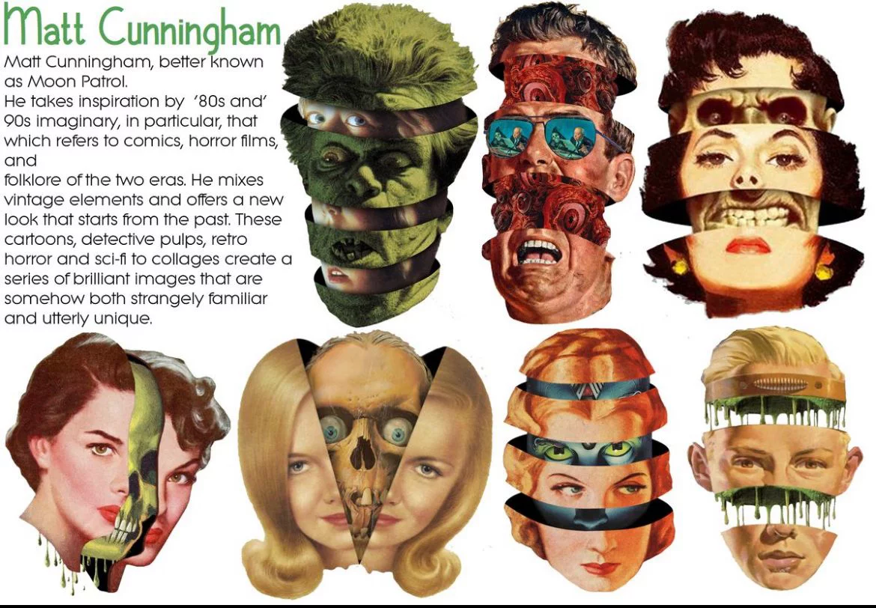
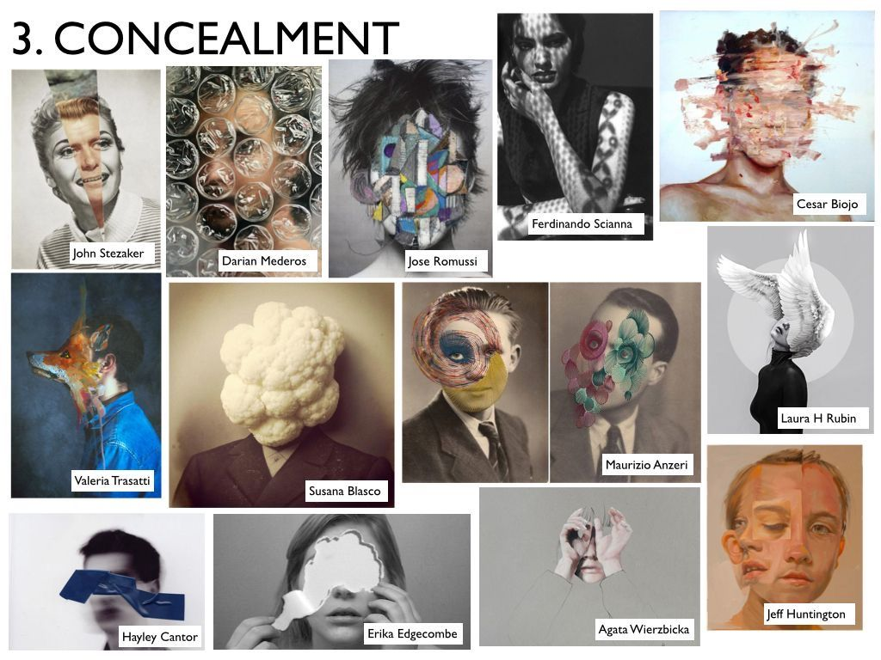
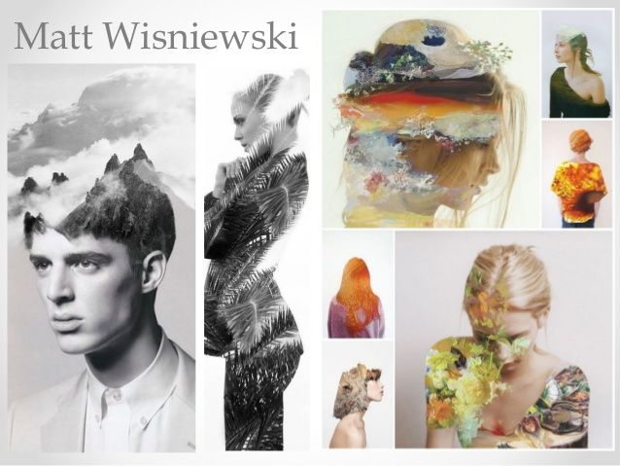
Concealed, Revealed

Slide 7
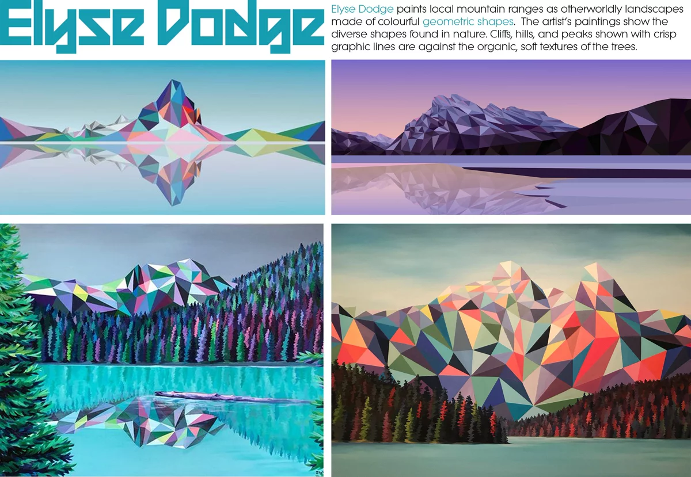
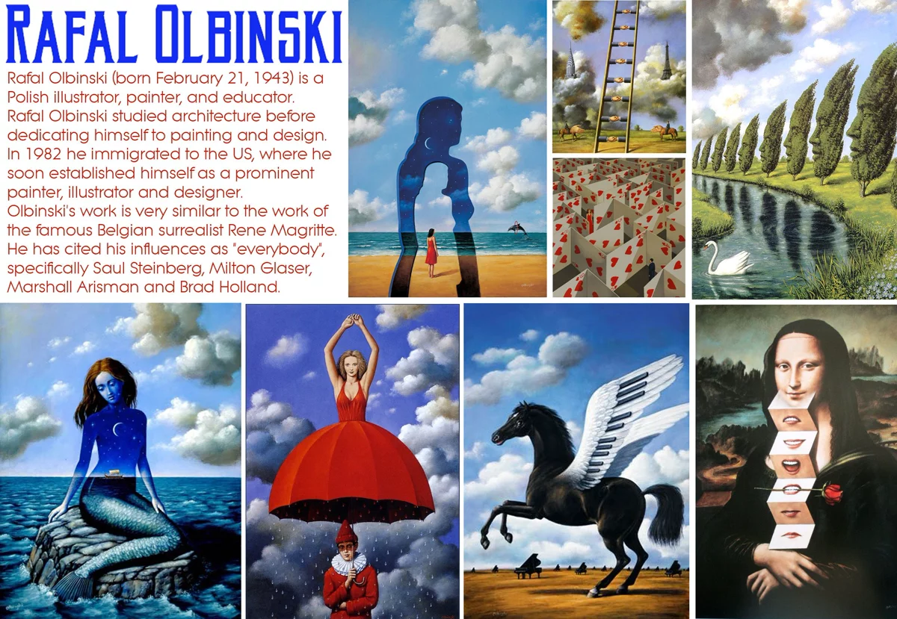


Slide 8
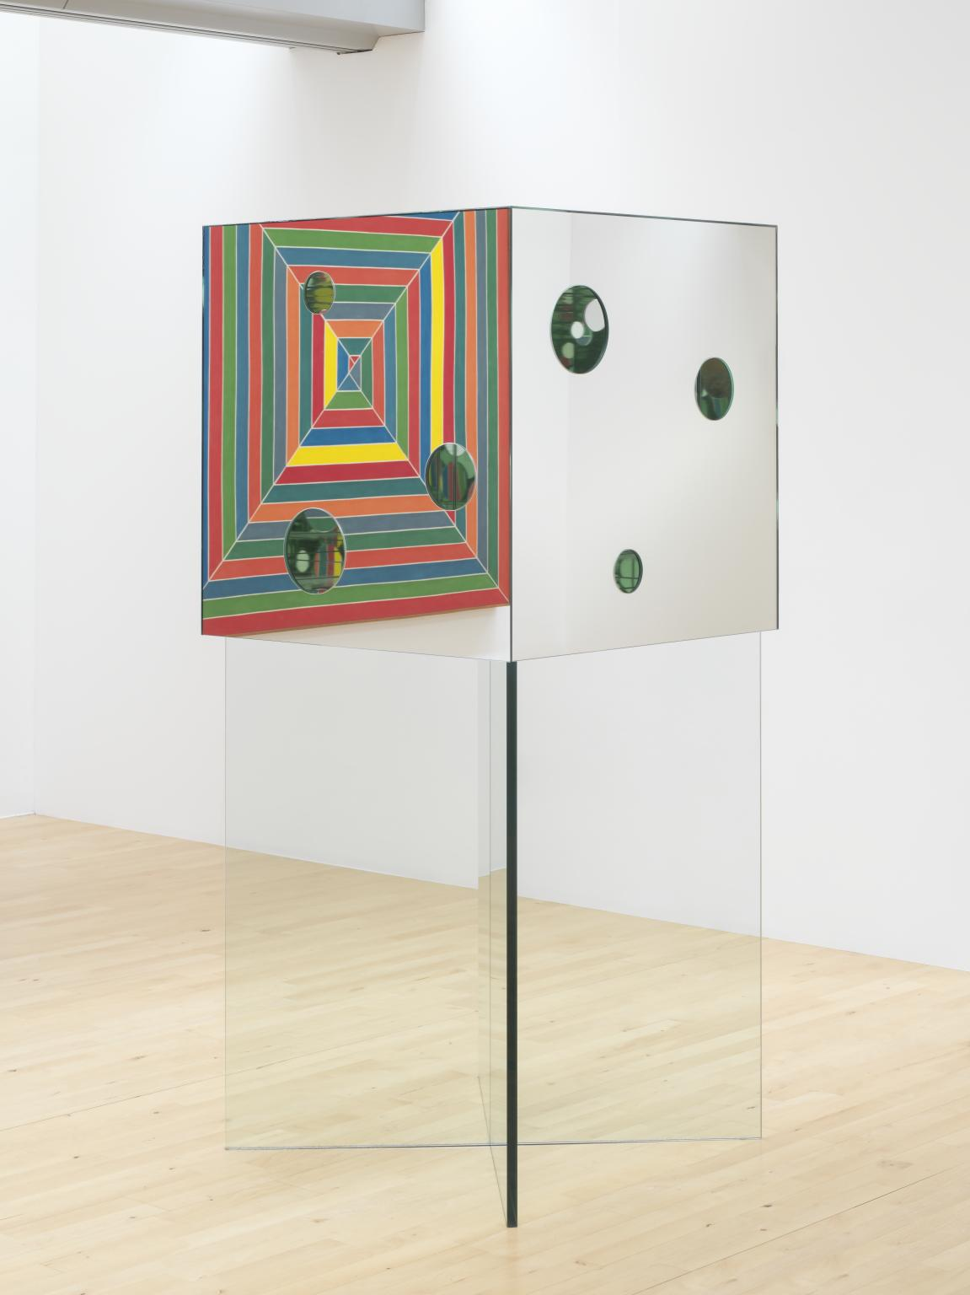
https://www.tate.org.uk/art/artworks/kusama-the-passing-winter-t12821
Yayoi Kusama The Passing Winter 2005
The Passing Winter 2005 is a sculpture comprising a cube positioned on two thick panes of glass, which are arranged to form an x-shaped pedestal. The cube, which is also made of glass, has an interior and exterior lined with mirrors, and its sides each contain three circular holes of different sizes arranged in varying compositions. Viewers are invited to look through these holes to the inside of the box and in doing so can see the circular shapes that are cut into the cube’s walls reflected infinitely across its mirror-lined interior. This gives the impression of an indefinite, ever-receding space in which the reflected circles seem to float. The spectator might also see reflections of other viewers peering in through holes in the box’s other sides. The cube’s mirrored surfaces cause its appearance to alter with varying environmental conditions: the reflected dots inside the box take on different colours depending on the colour of the surrounding room, and the reflections alter in brightness depending on light conditions.

Slide 9
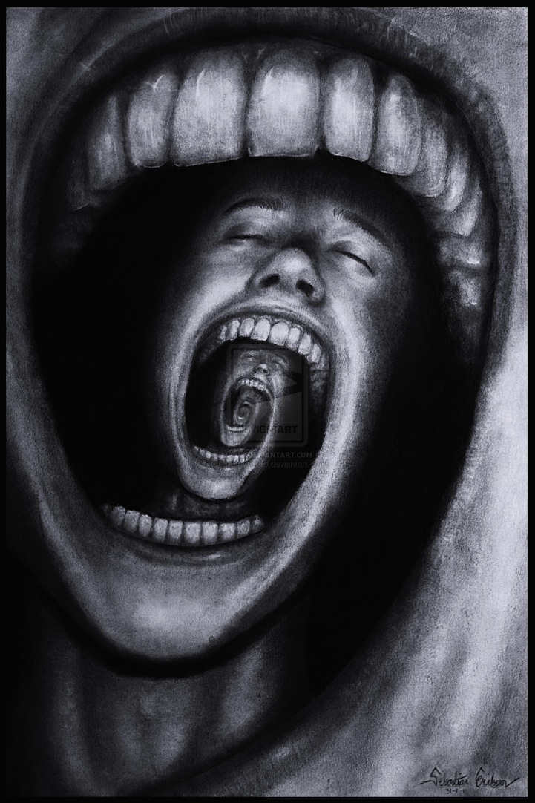
https://mymodernmet.com/sebastian-eriksson-surreal-art/
Sebastian Eriksson is an 18-year-old up-and-coming surrealist artist living in Sweden. Not only is his artwork amazing, it's extremely thought-provoking as he adds descriptions of how his pieces relate to his life.
For instance, in the piece above, he states: “This is another paradox that I've been working on for a couple of days. It describes a person with psychological problems such as schizophrenia, insanity, depression or other mental problems. His endless screaming makes his own mind eat him up. I have periods in my life where I feel like this. I wanted to make an illustration of my thoughts and my pain within.”
And for the piece immediately below: “One day I felt like I was lost and I had too much things to think about. Like I was stuck in a maze and couldn't get out.”

Slide 10
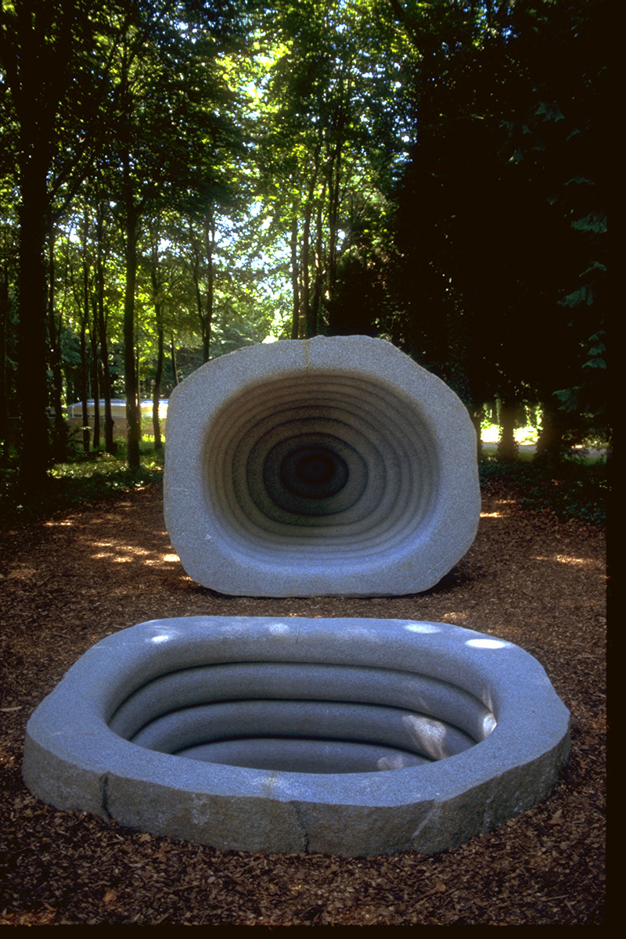
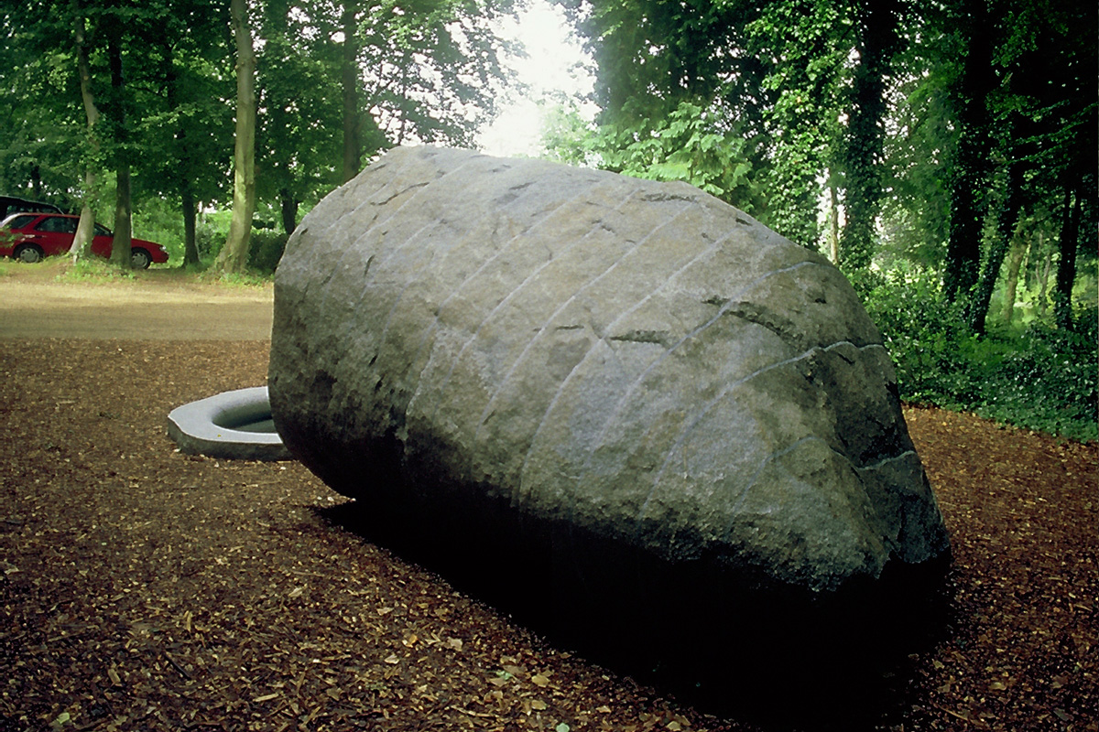
Womb Tomb
2000
Granite Boulder
230 x 335 x 270 cm
213 x 270 x 230 cm
https://www.peterrandall-page.com/sculptures/womb-tomb/

Slide 11
Analyse the composition.
Describe how the elements have been arranged.
Explain the effect this creates – how it leads the viewers eye. The feeling/atmosphere.
Womb Tomb
2000
Granite Boulder

Slide 12


