Slide 1
Reading
Prose Component 2

Slide 2
READING:
Handmaid’s Tale by Margaret Atwood
Link to purchase:
https://www.amazon.co.uk/Handmaids-Tale-Vintage-Classics/dp/1784873187/ref=pd_lpo_sccl_1/258-5093304-9656803?pd_rd_w=4H49N&content-id=amzn1.sym.efc89c20-c5a9-4620-b6cd-2f4e51bac956&pf_rd_p=efc89c20-c5a9-4620-b6cd-2f4e51bac956&pf_rd_r=WXMVPB0XD5YQ14609X0W&pd_rd_wg=FYHWQ&pd_rd_r=9591eaaa-dc04-4436-ae9b-e2c1e9521bec&pd_rd_i=1784873187&psc=1
Frankenstein by Mary Shelley
Link to purchase:
https://www.amazon.co.uk/Frankenstein-1818-Text-Penguin-Classics-ebook/dp/B071NCSKSP/ref=sr_1_6?keywords=frankenstein+by+mary+shelley&qid=1687954984&sprefix=frankenstein+by+%2Caps%2C105&sr=8-6

Slide 3
Watch the TED Talk on ‘The Handmaid’s Tale’ and answer the following questions
When was the novel written?
What is speculative fiction?
What is a Utopia?
What is a Dystopia?
When was the novel published?
How and why are women categorised?
What is self imposed rule?
Where is the novel set? Why was it set here?
What are the parallels with Puritanism?
Who is Atwood descended from?
What do you learn about Offred’s life?
How is language significant in the novel?
What drives the plot?

Slide 4


Slide 5
Frankenstein research tasks
Research the following in more detail to further your background knowledge:
a. Literary Romanticism
b. The French Revolution – ideas of thinkers such as Rousseau and Diderot.
c. Mary and Percy’s relationship – why was it scandalous? How may this have influenced Frankenstein?
d. The ghost story competition that Mary Shelley won with Frankenstein.
e. The philosophy and politics of Mary’s mother, father and their radical friends
Use the TED Talk on the next slide to support your research but ensure you complete some wider reading as well.

Slide 6
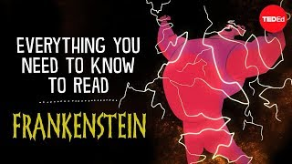

Slide 7
Christina Rossetti
Research Task - Poetry Component 3

Slide 8
BBC Radio 4 - Documentary - https://www.bbc.co.uk/sounds/play/b017mvwy
Listen to the BBC Radio 4 broadcast on Christina Rossetti’s life and Poetry.
Create notes of anything that you learn about Rossetti.

Slide 9
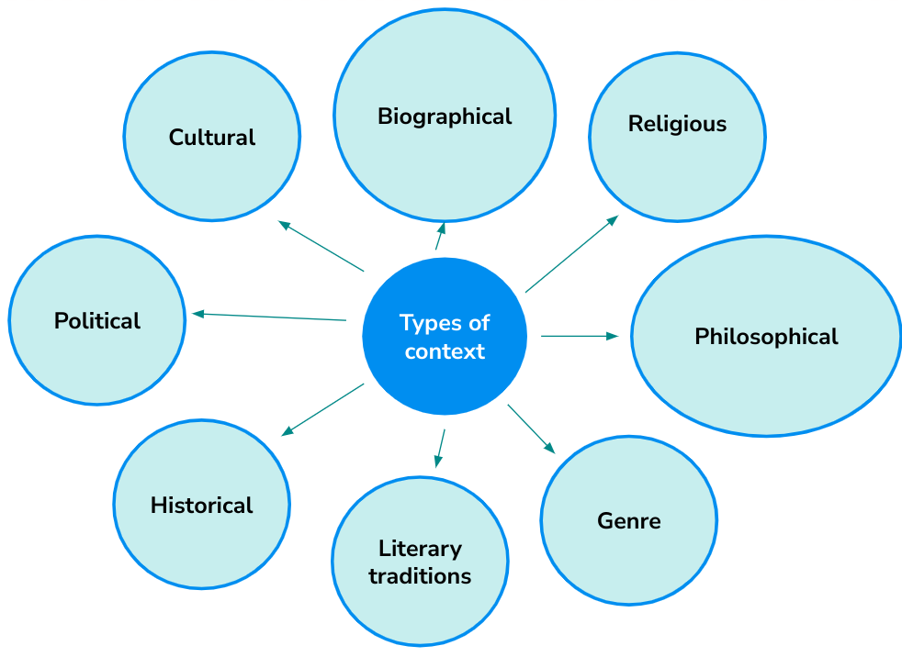
Research Task -
Complete research and notes on the poet Christina Rossetti based on these different types of context.
You need to understand her as a person in order to understand her as poet.

