Slide 1

TASK
carry out at least 4 photoshoots.
Each photoshoot should be 35 photographs, focused on the TPG activities attached.
All instructions are on the activity sheets.
https://thephotographersgallery.org.uk

Slide 2
Presenting your work
Create a PowerPoint presentation of your photoshoots.
Include a title
a contact sheet of your shoot
Your chosen selection of your best photographs.
Lastly, writing to explain why and how you took the pictures.
Do you need to crop the pictures?
Take a screen shot for a contact sheet
Upload your work onto google classroom by the deadline.

Slide 3
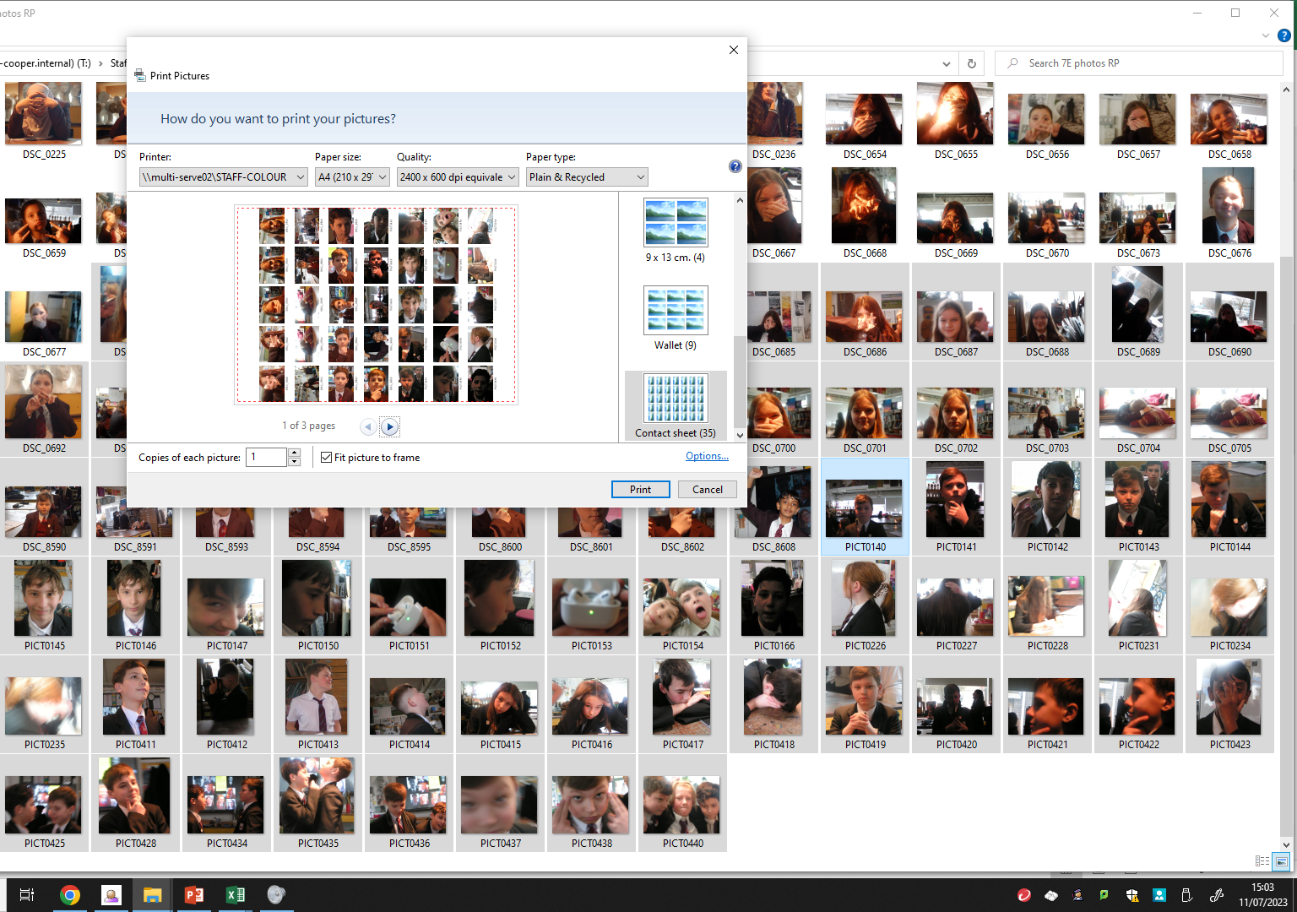
Creating a contact sheet
You can take a screen shot from your computer after opening your folder of images. Crop it and add to your PowerPoint.
Or you can select the ‘contact sheet’ option if you were printing your images for your sketchbook.

